Slide 1
Model Risk Management Setup — Watson OpenScale and OpenPages MRG

Slide 2
This video takes you through how to set up your IBM Cloud environment to start using Watson OpenScale & IBM OpenPages
Create an IBMid and gain access to IBM Cloud dashboard
Provision all the necessary IBM Cloud services:
IBM Watson OpenScale
IBM Watson Machine Learning (pre-production & production instances)
IBM Watson Studio
Cloud Object Storage
Create projects in IBM Watson Studio that correspond to the pre-prod & prod Machine Learning instances
Enable MRM features in Watson OpenScale
Solution Makeup: Cloud Pak for Data with focus on Watson OpenScale

Slide 3
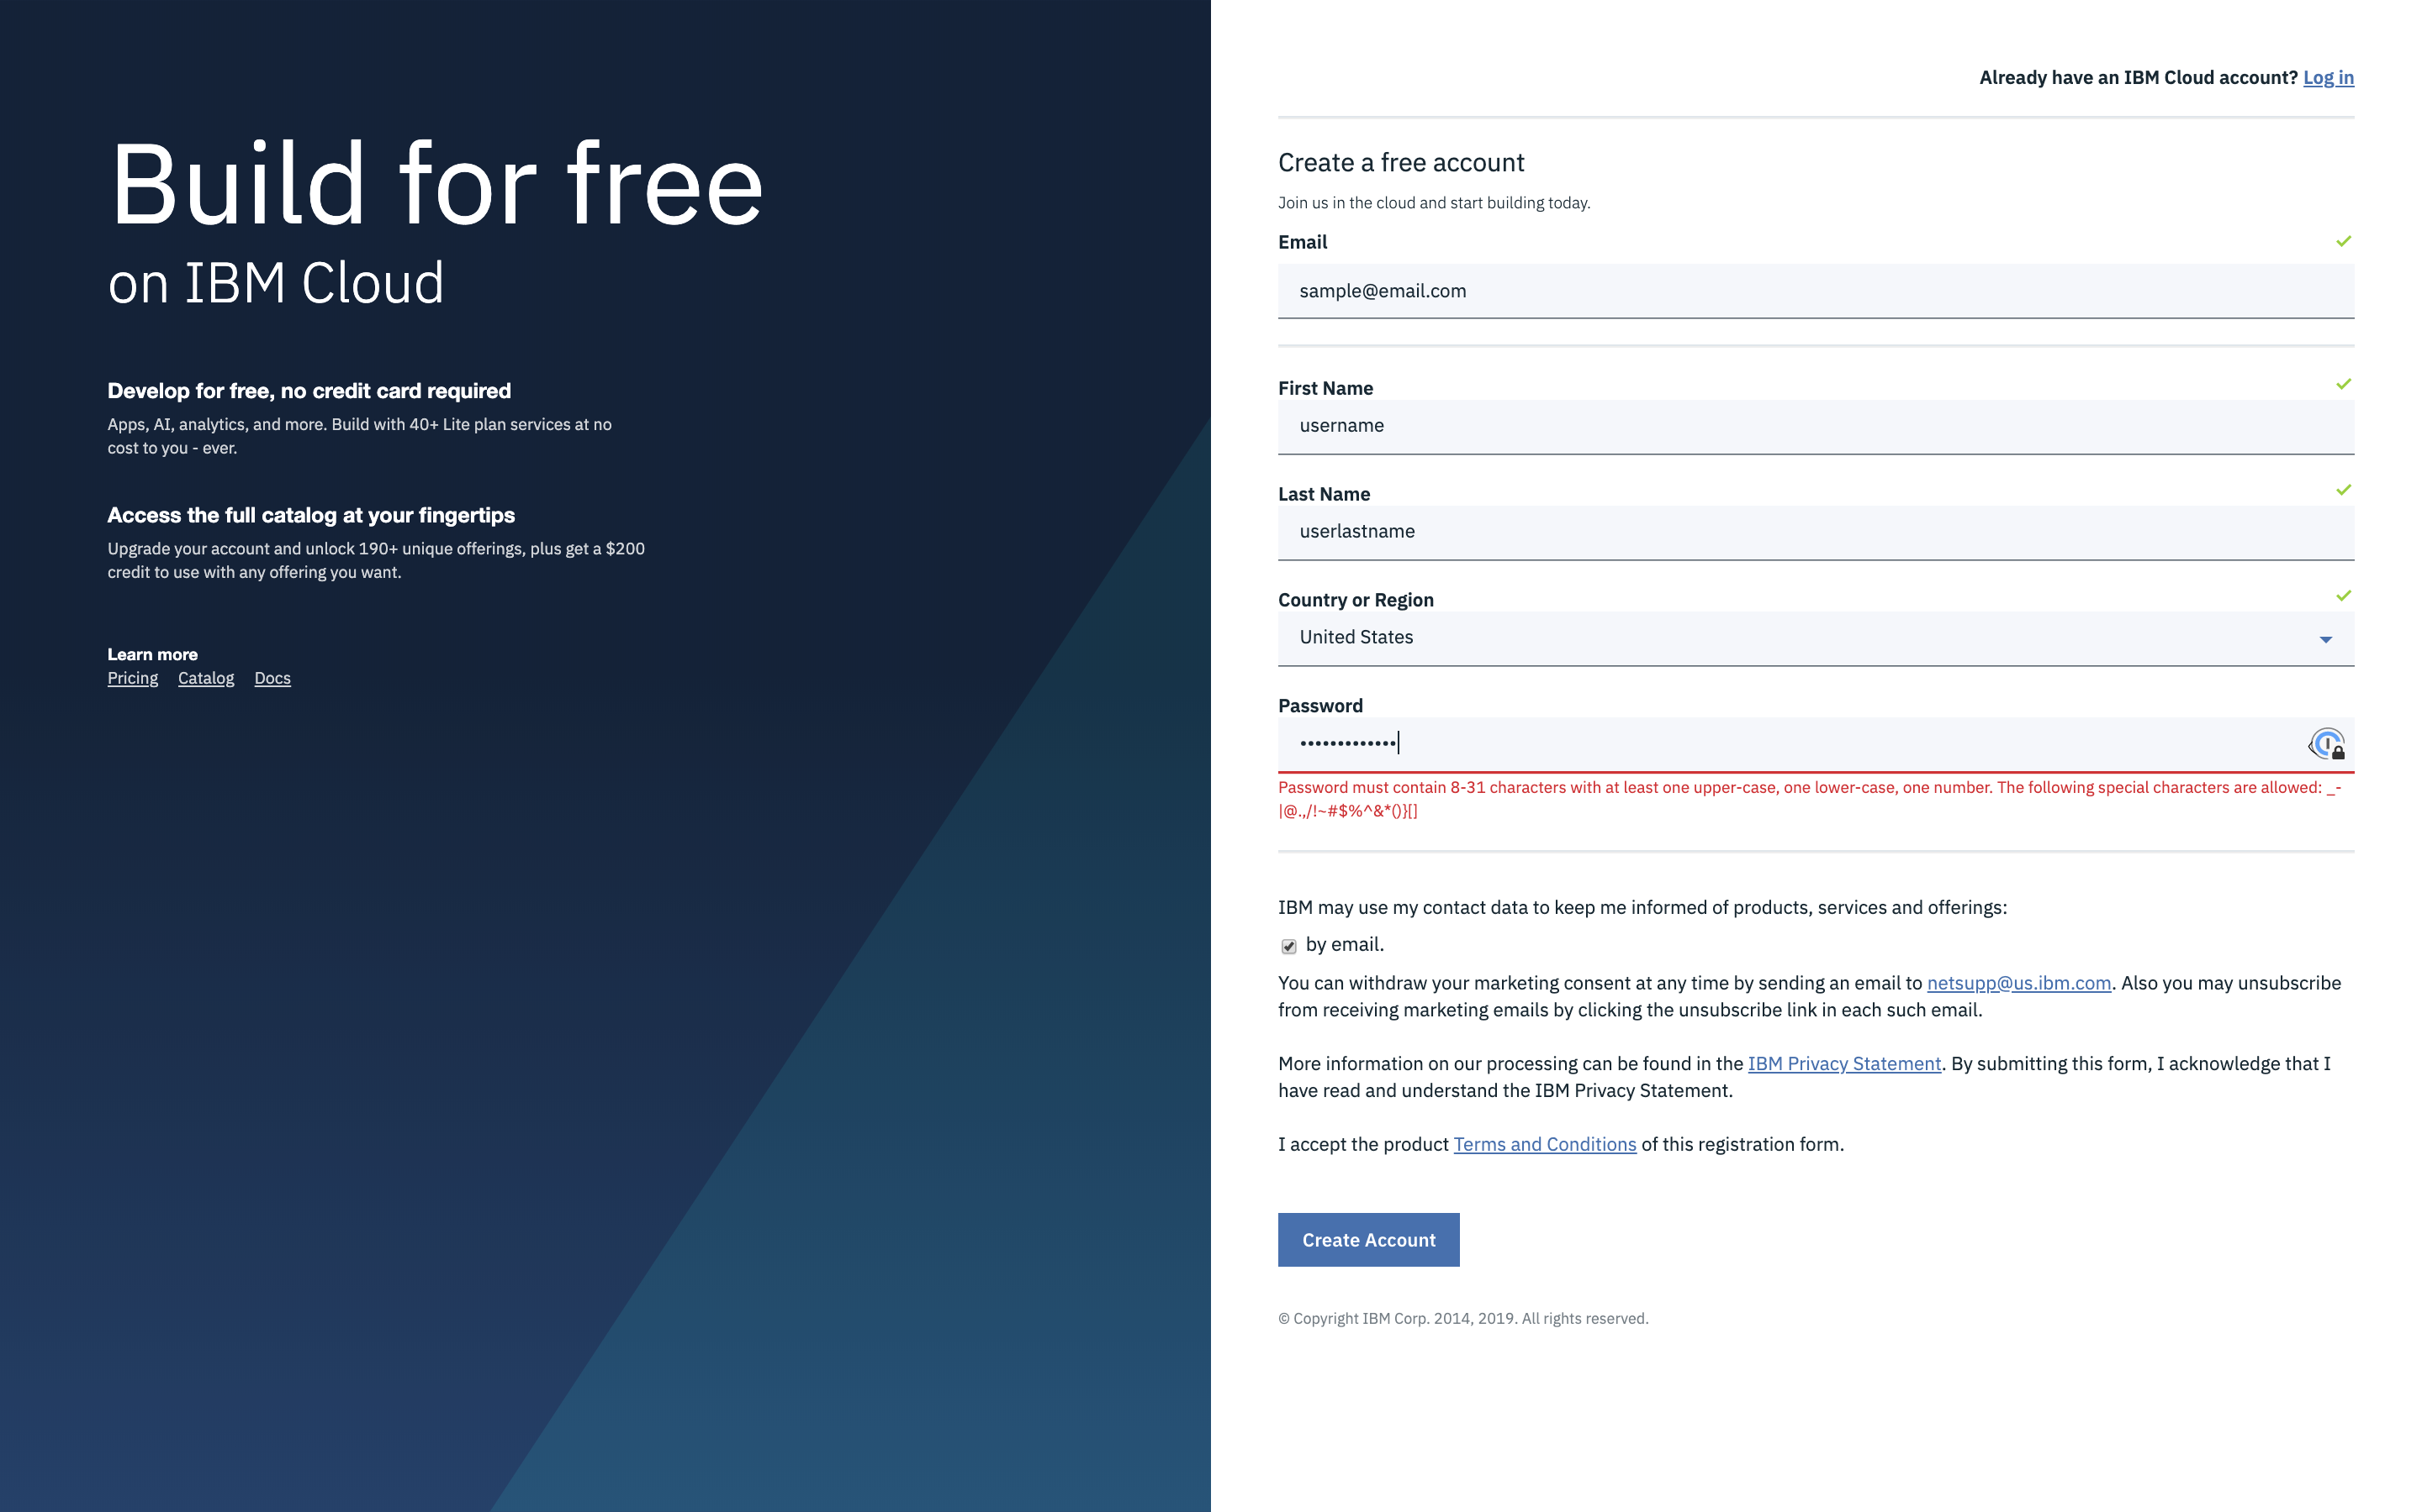
Point your browser at:
https://cloud.ibm.com/registration

Slide 4
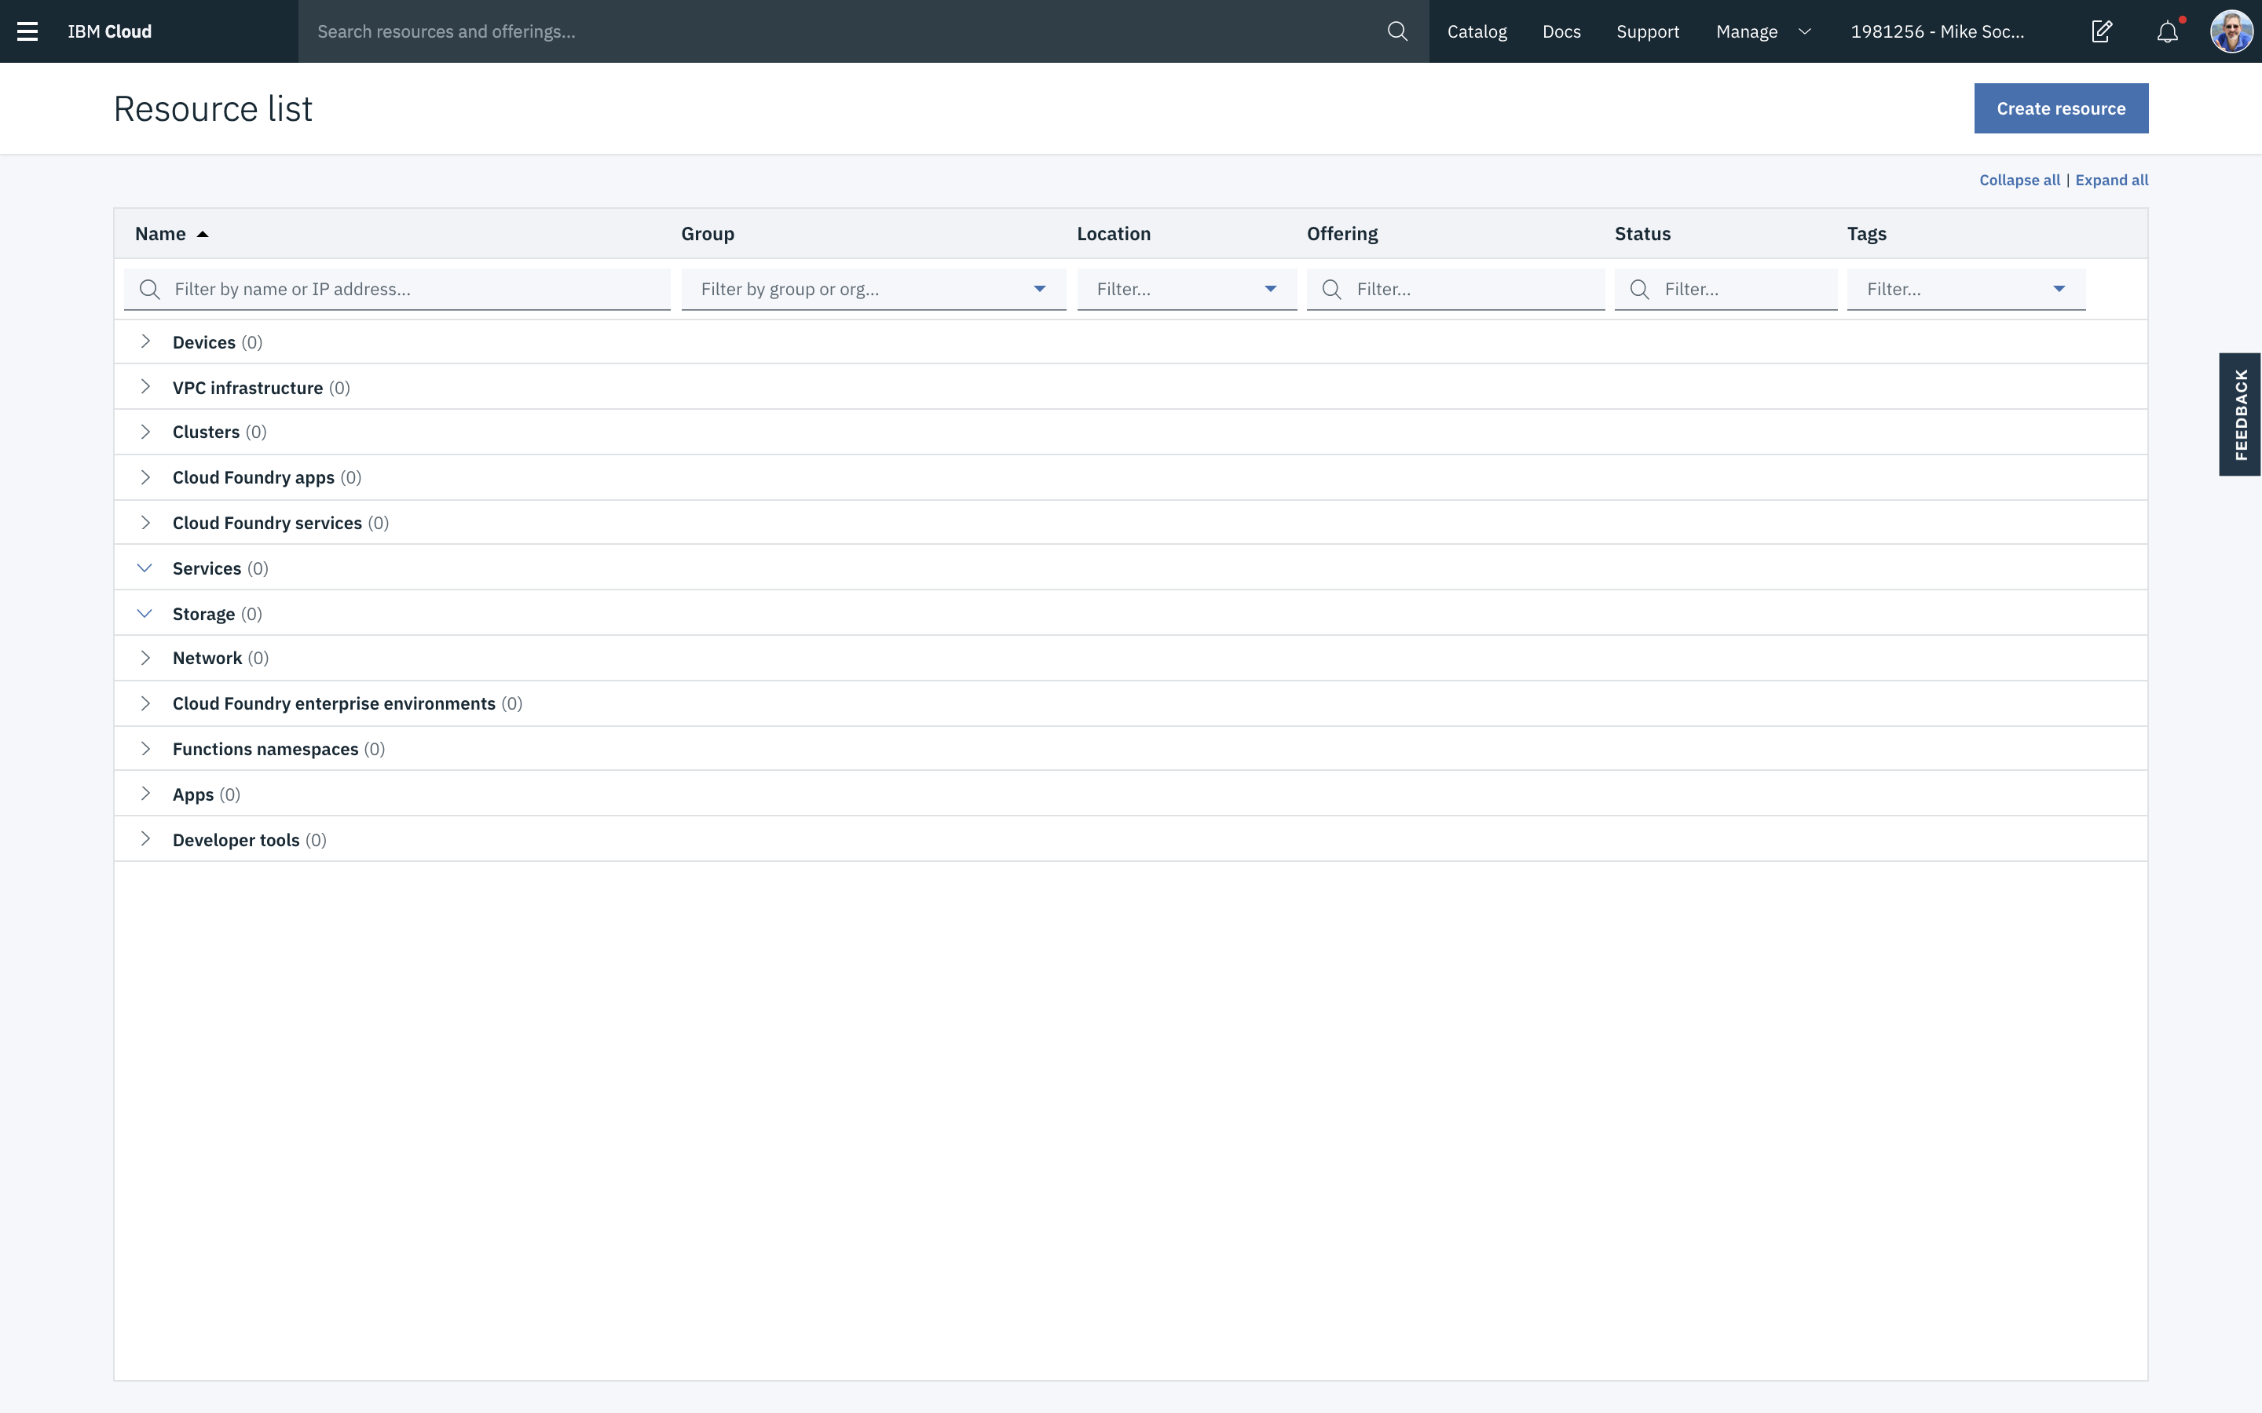

Slide 5
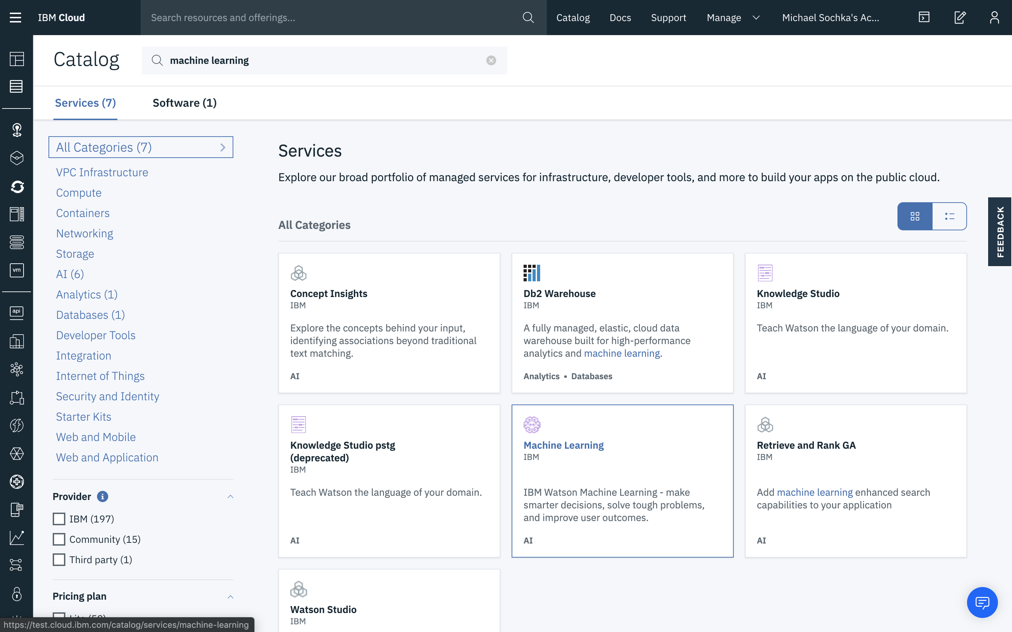

Slide 6
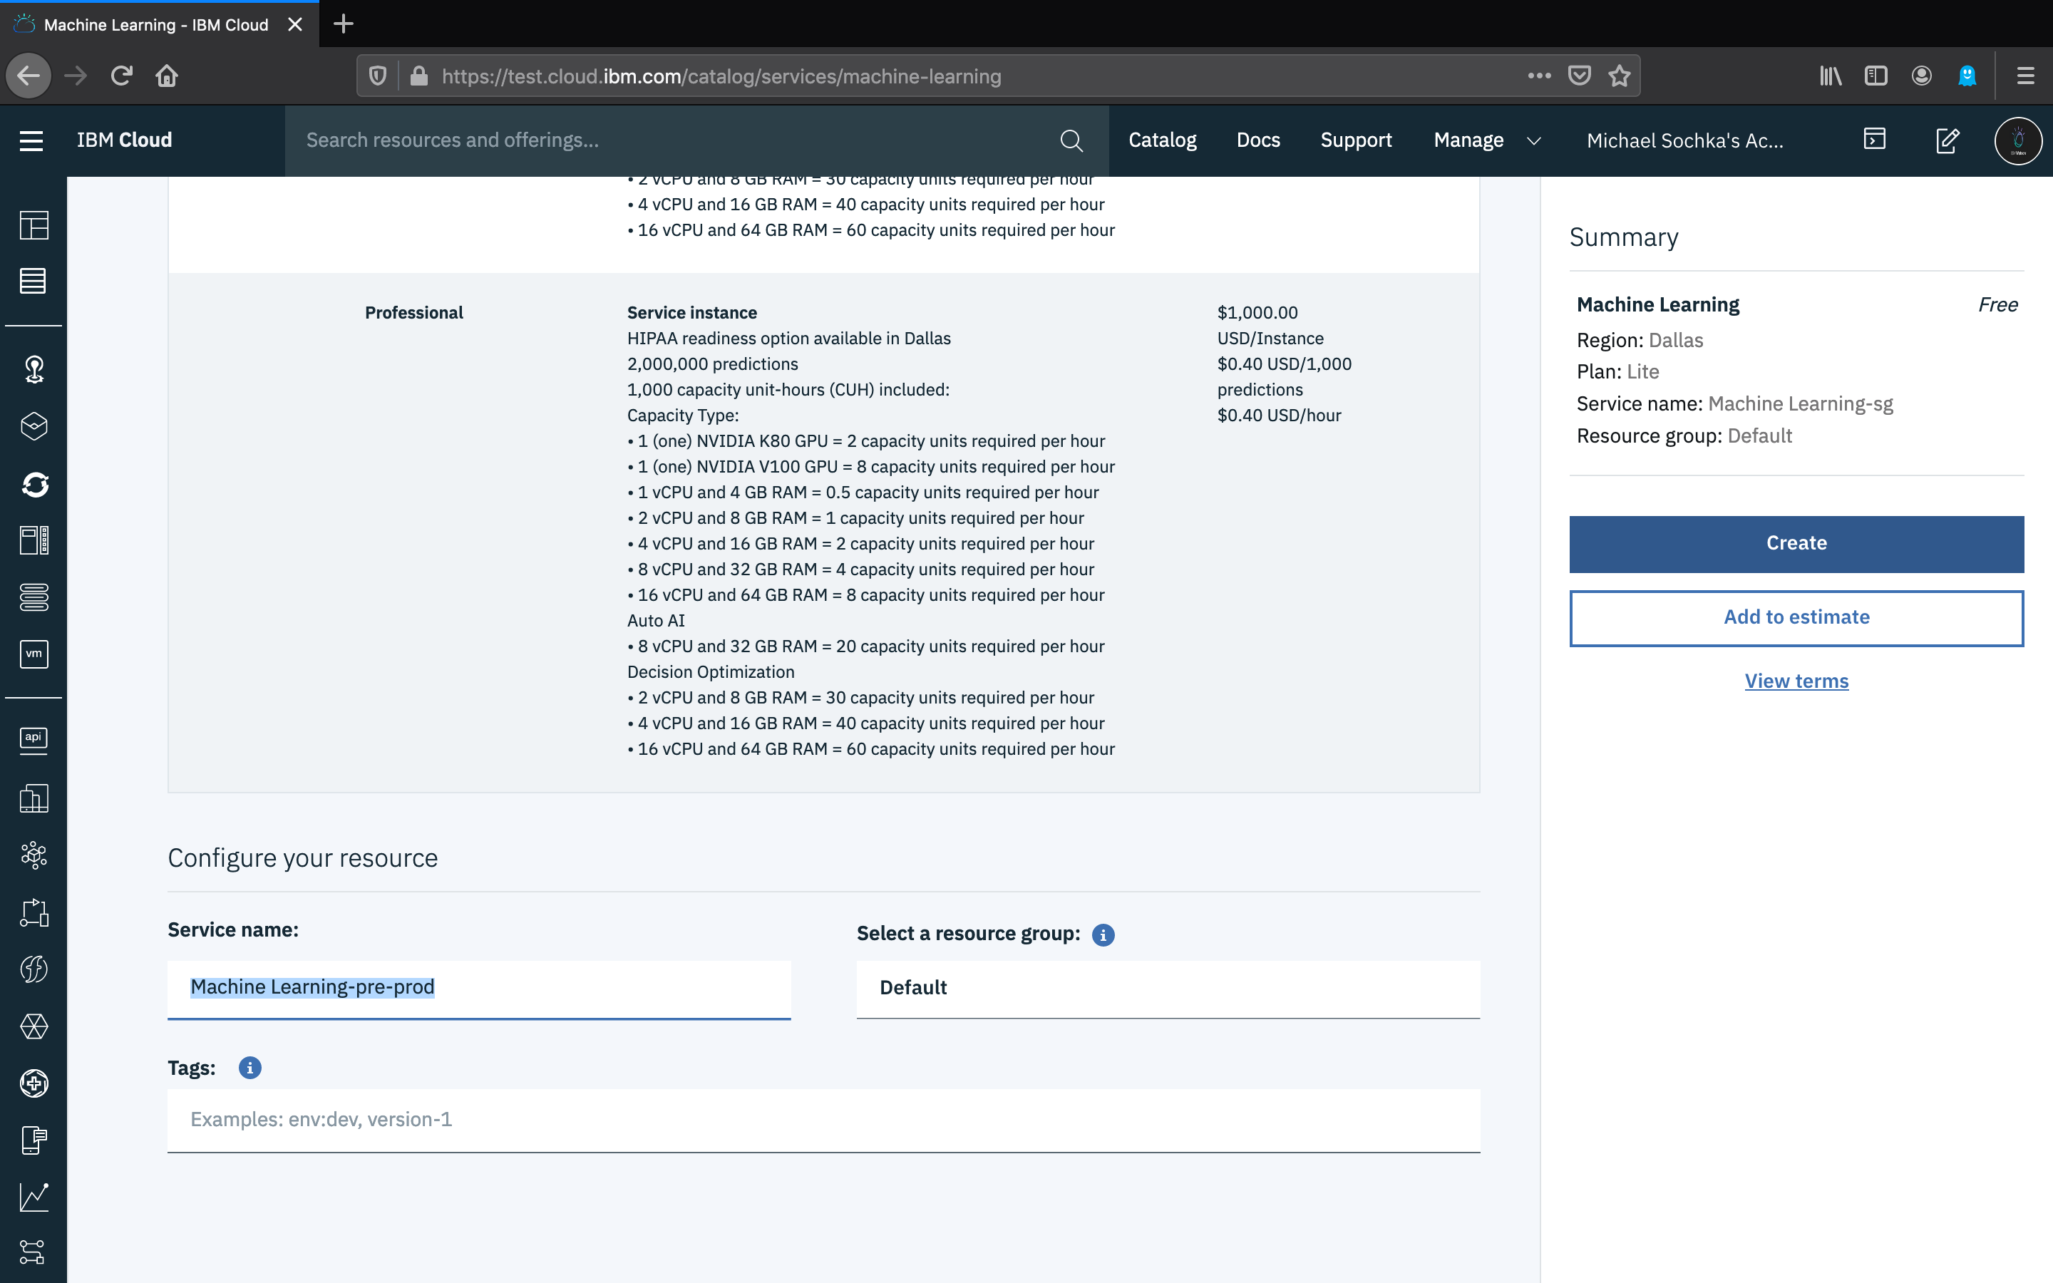

Slide 7
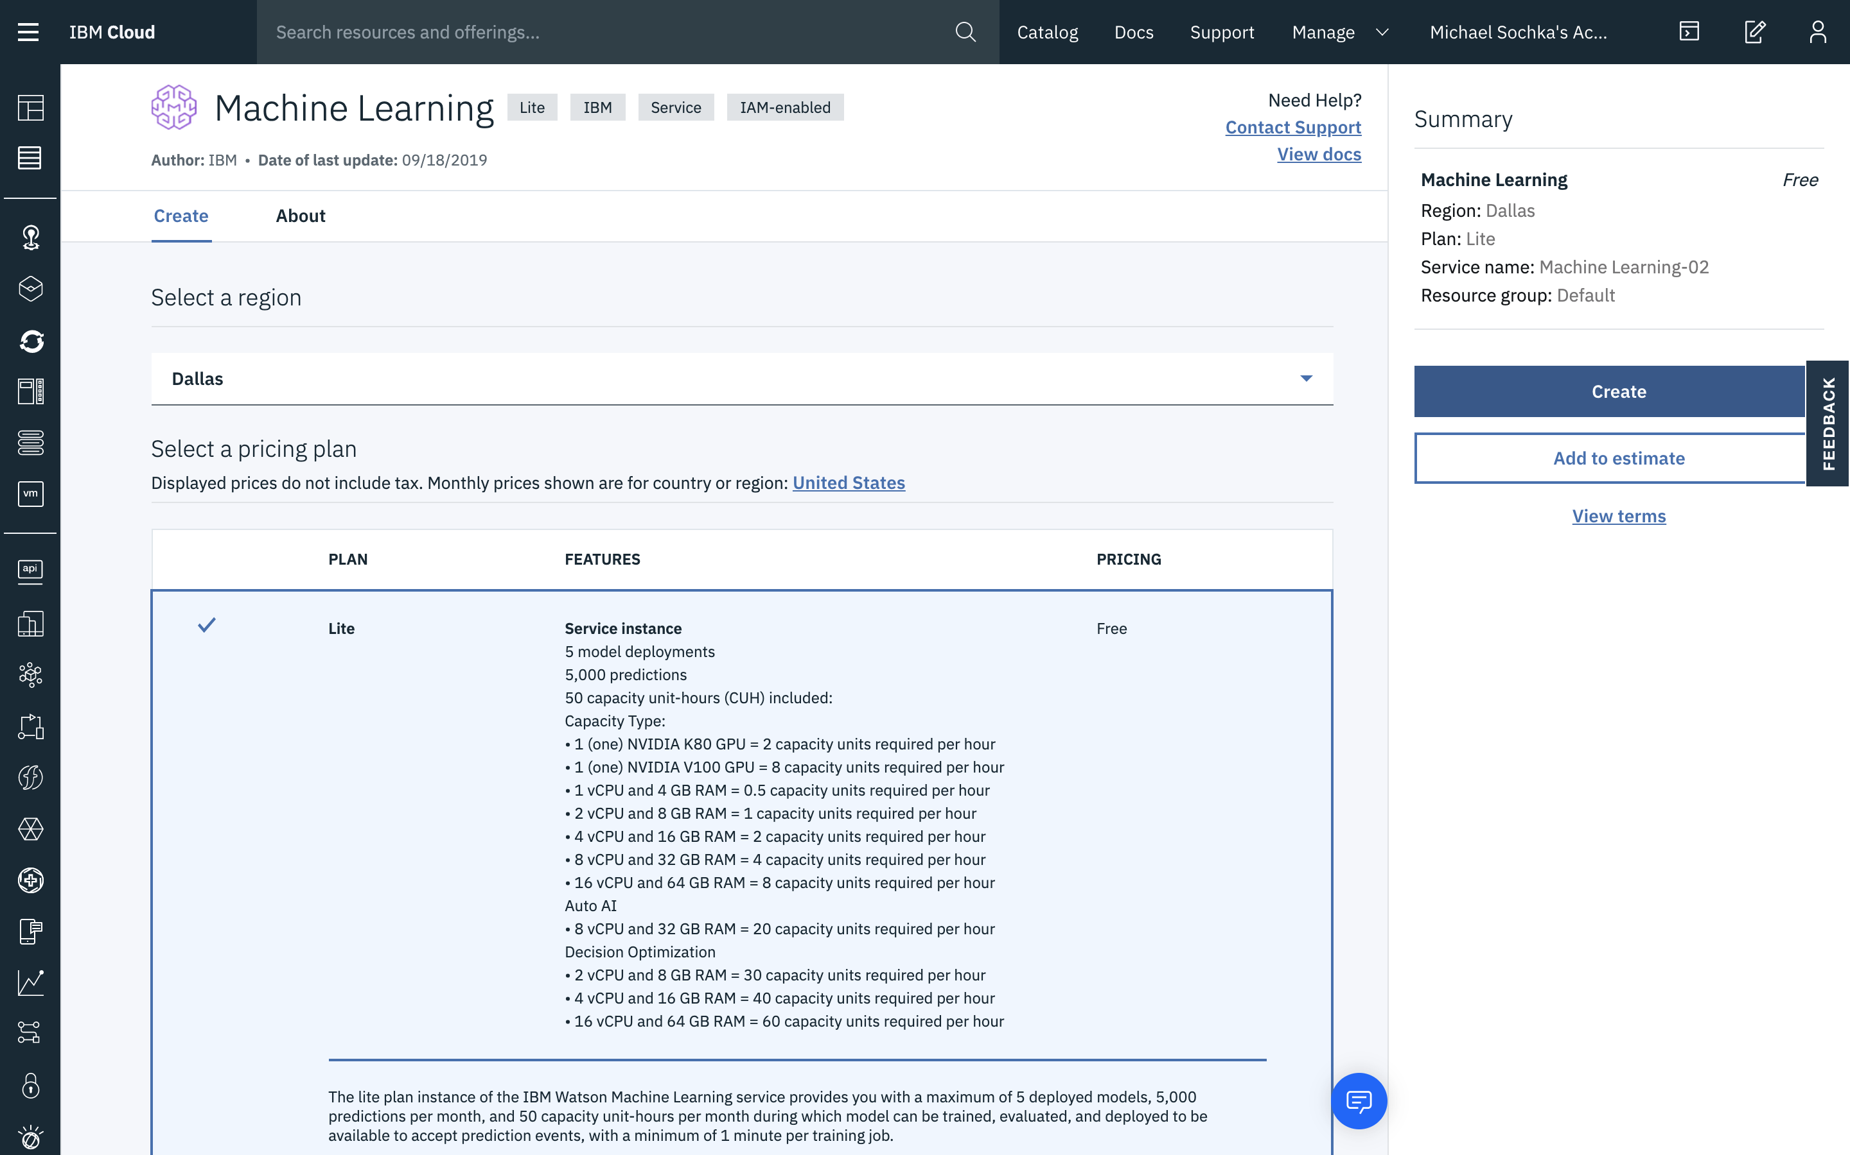

Slide 8
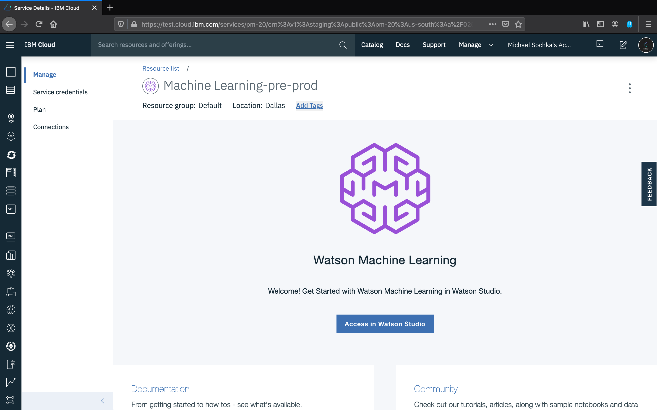

Slide 9
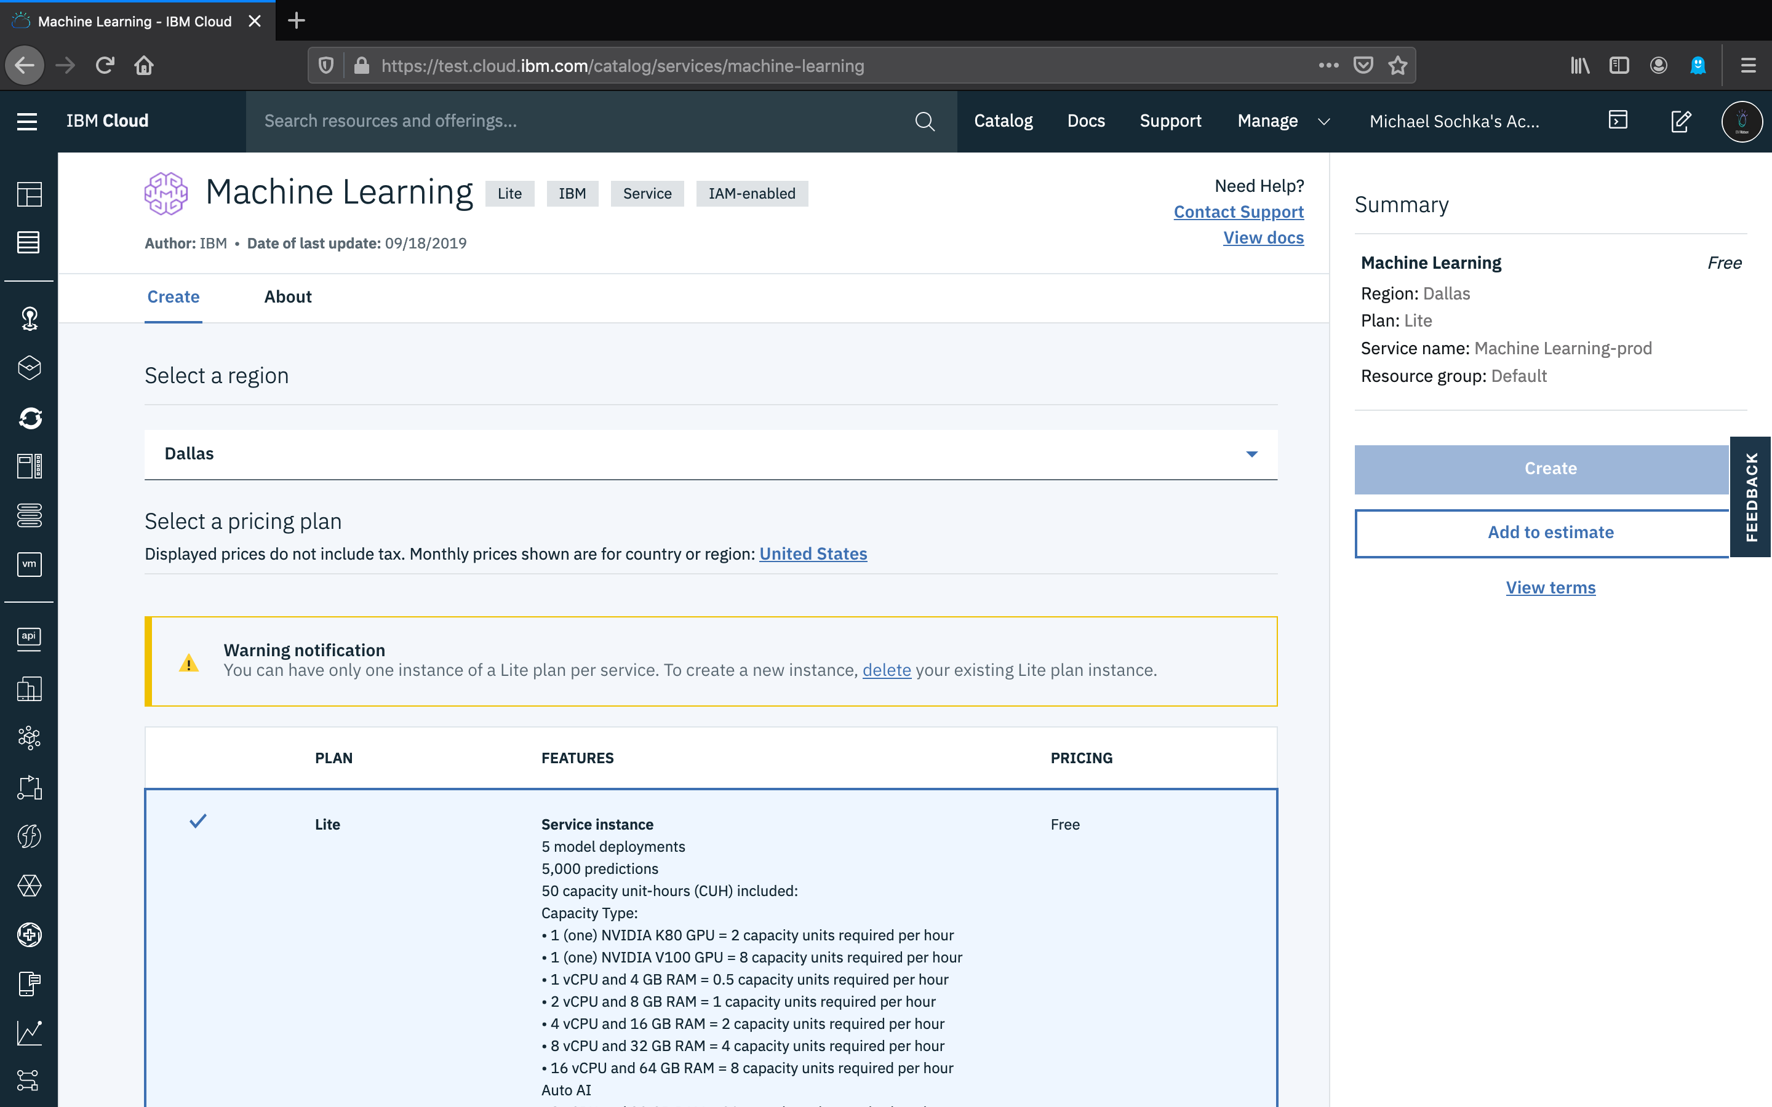

Slide 10
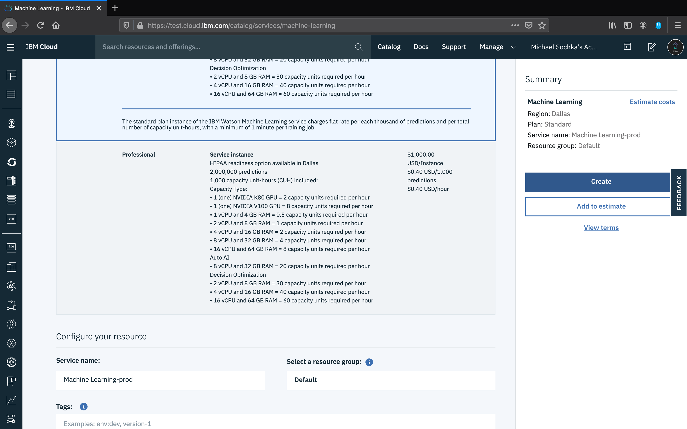

Slide 11
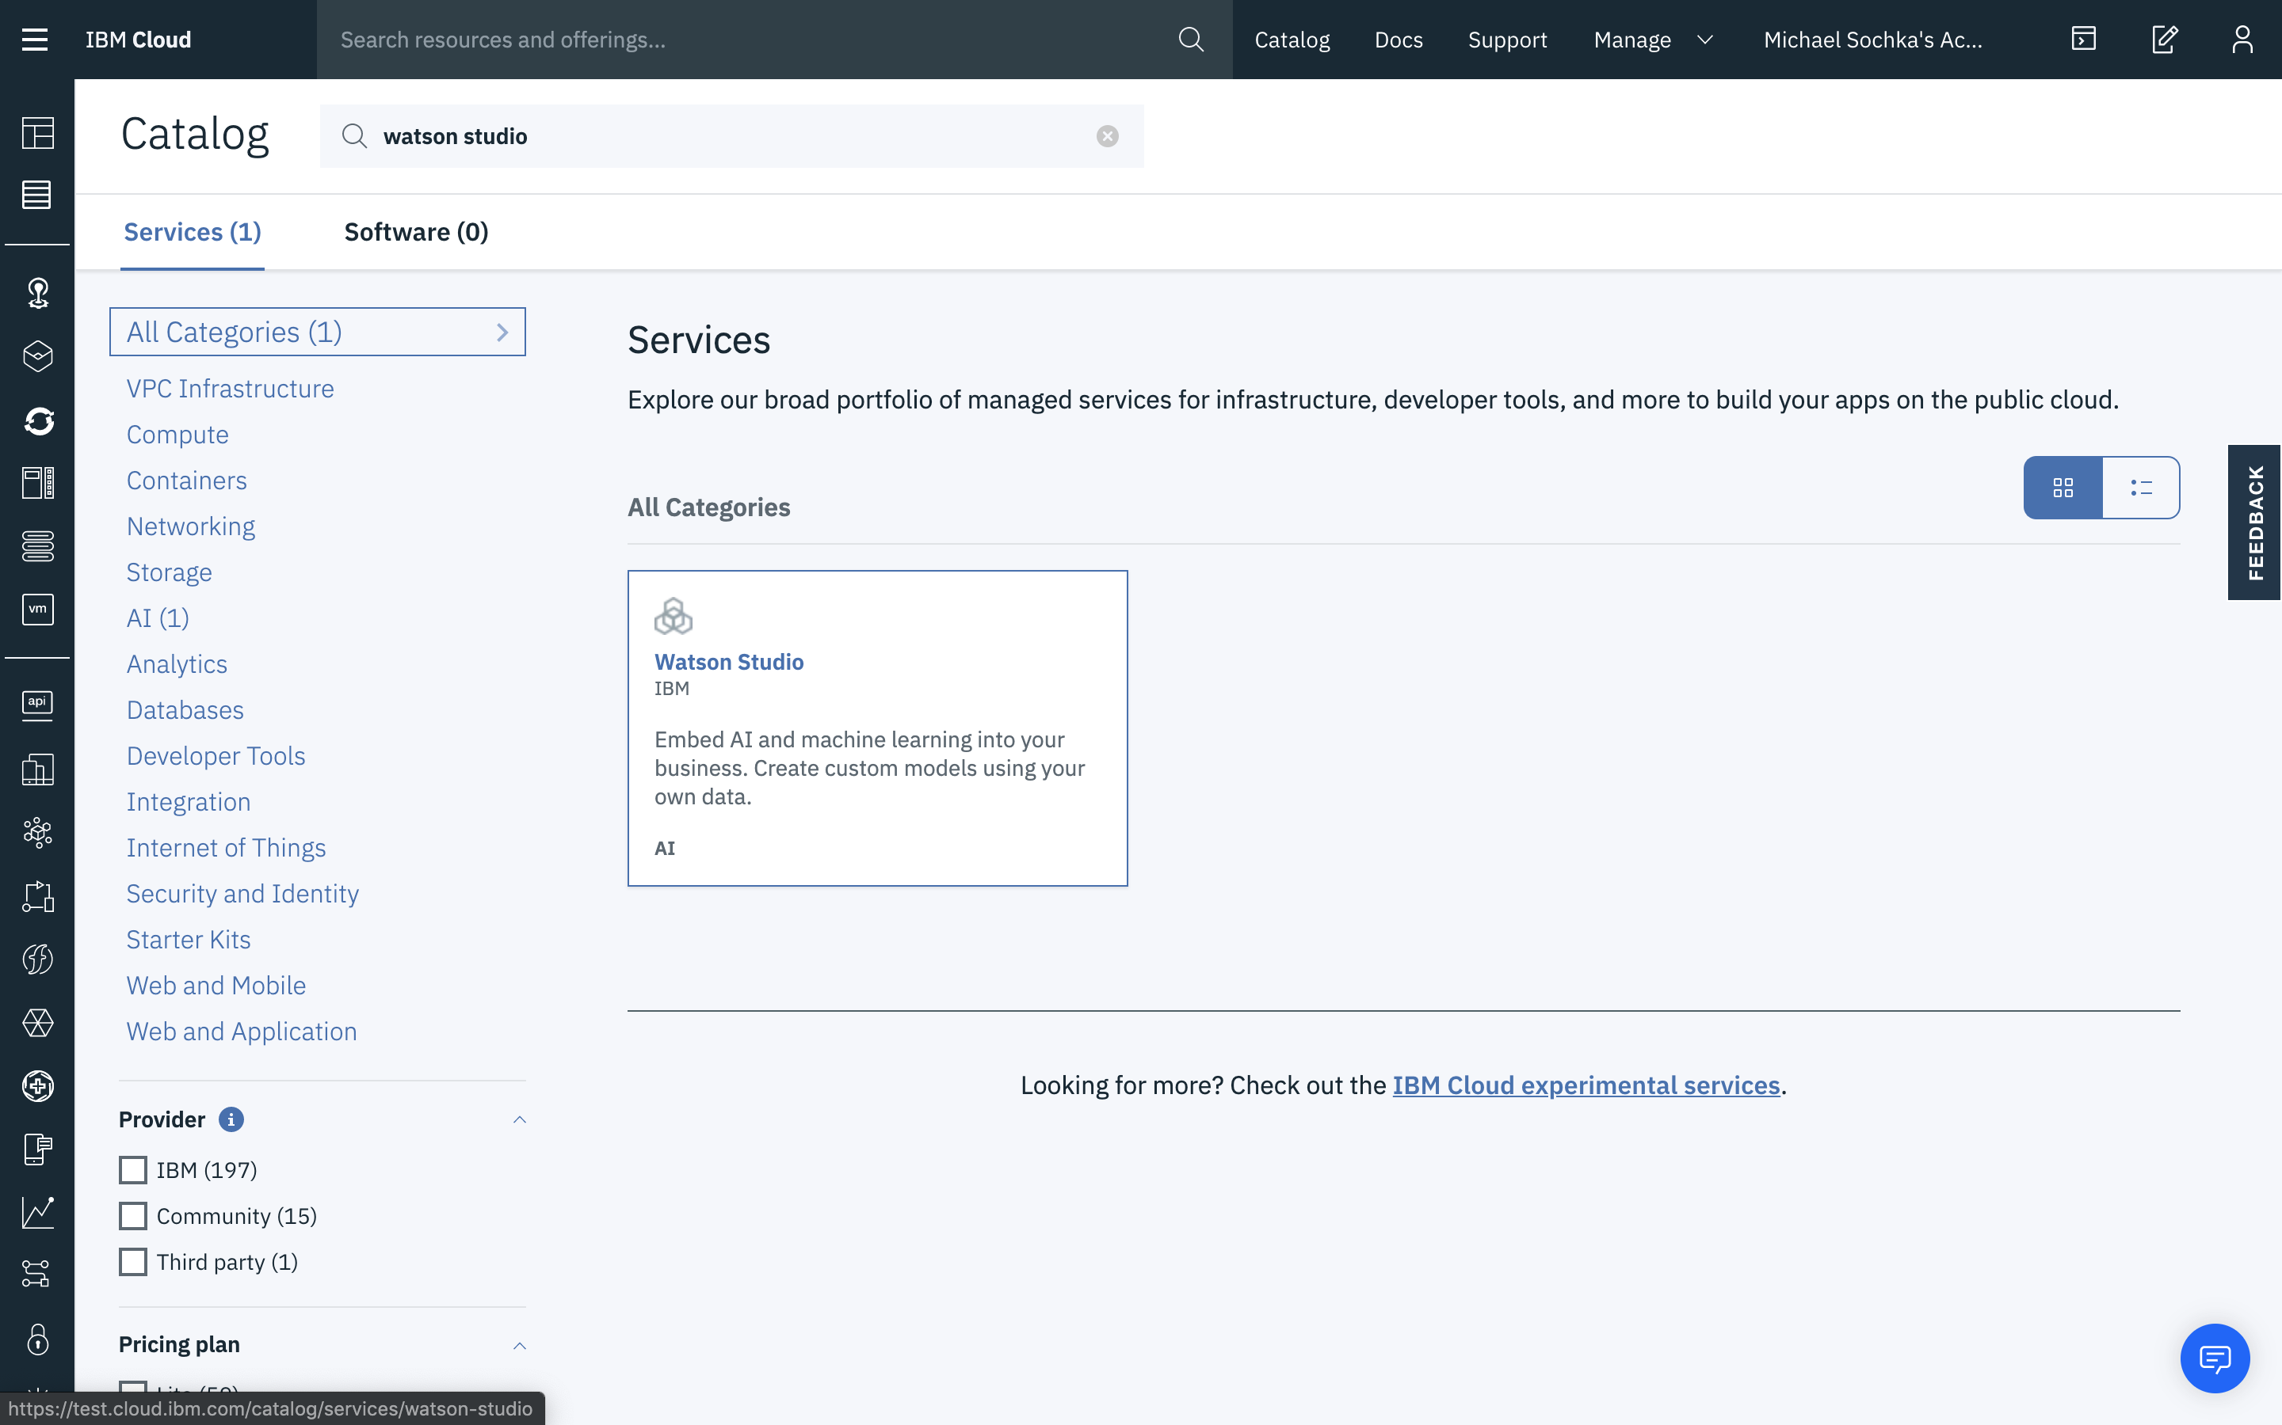

Slide 12
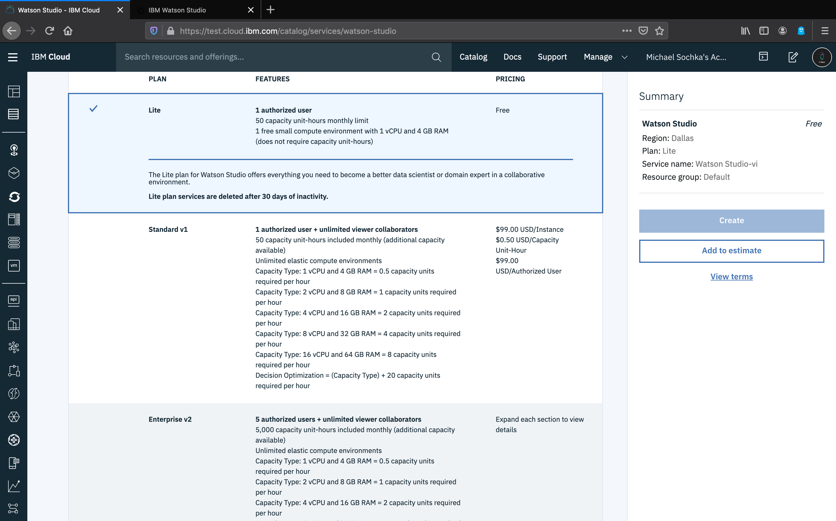

Slide 13
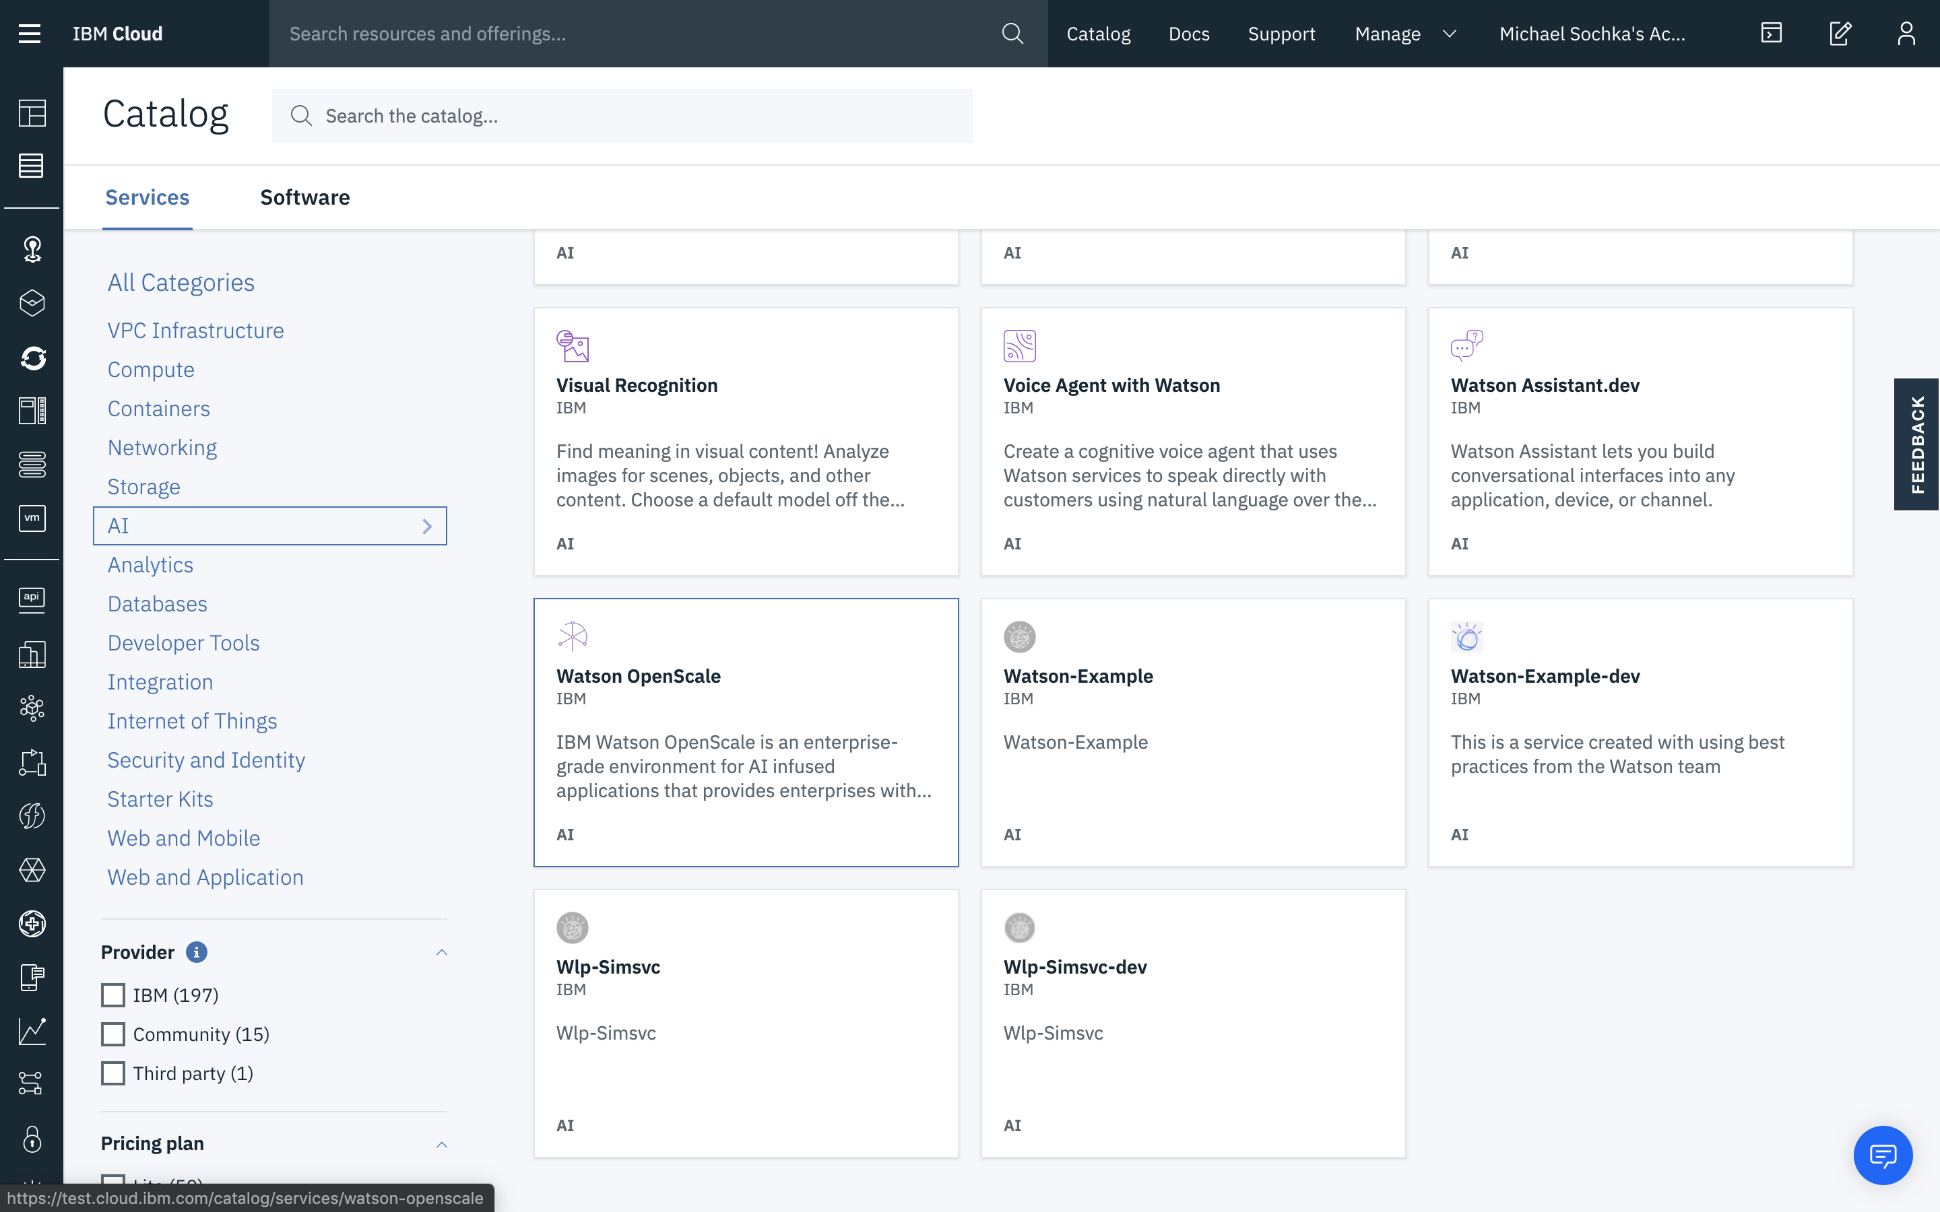

Slide 14
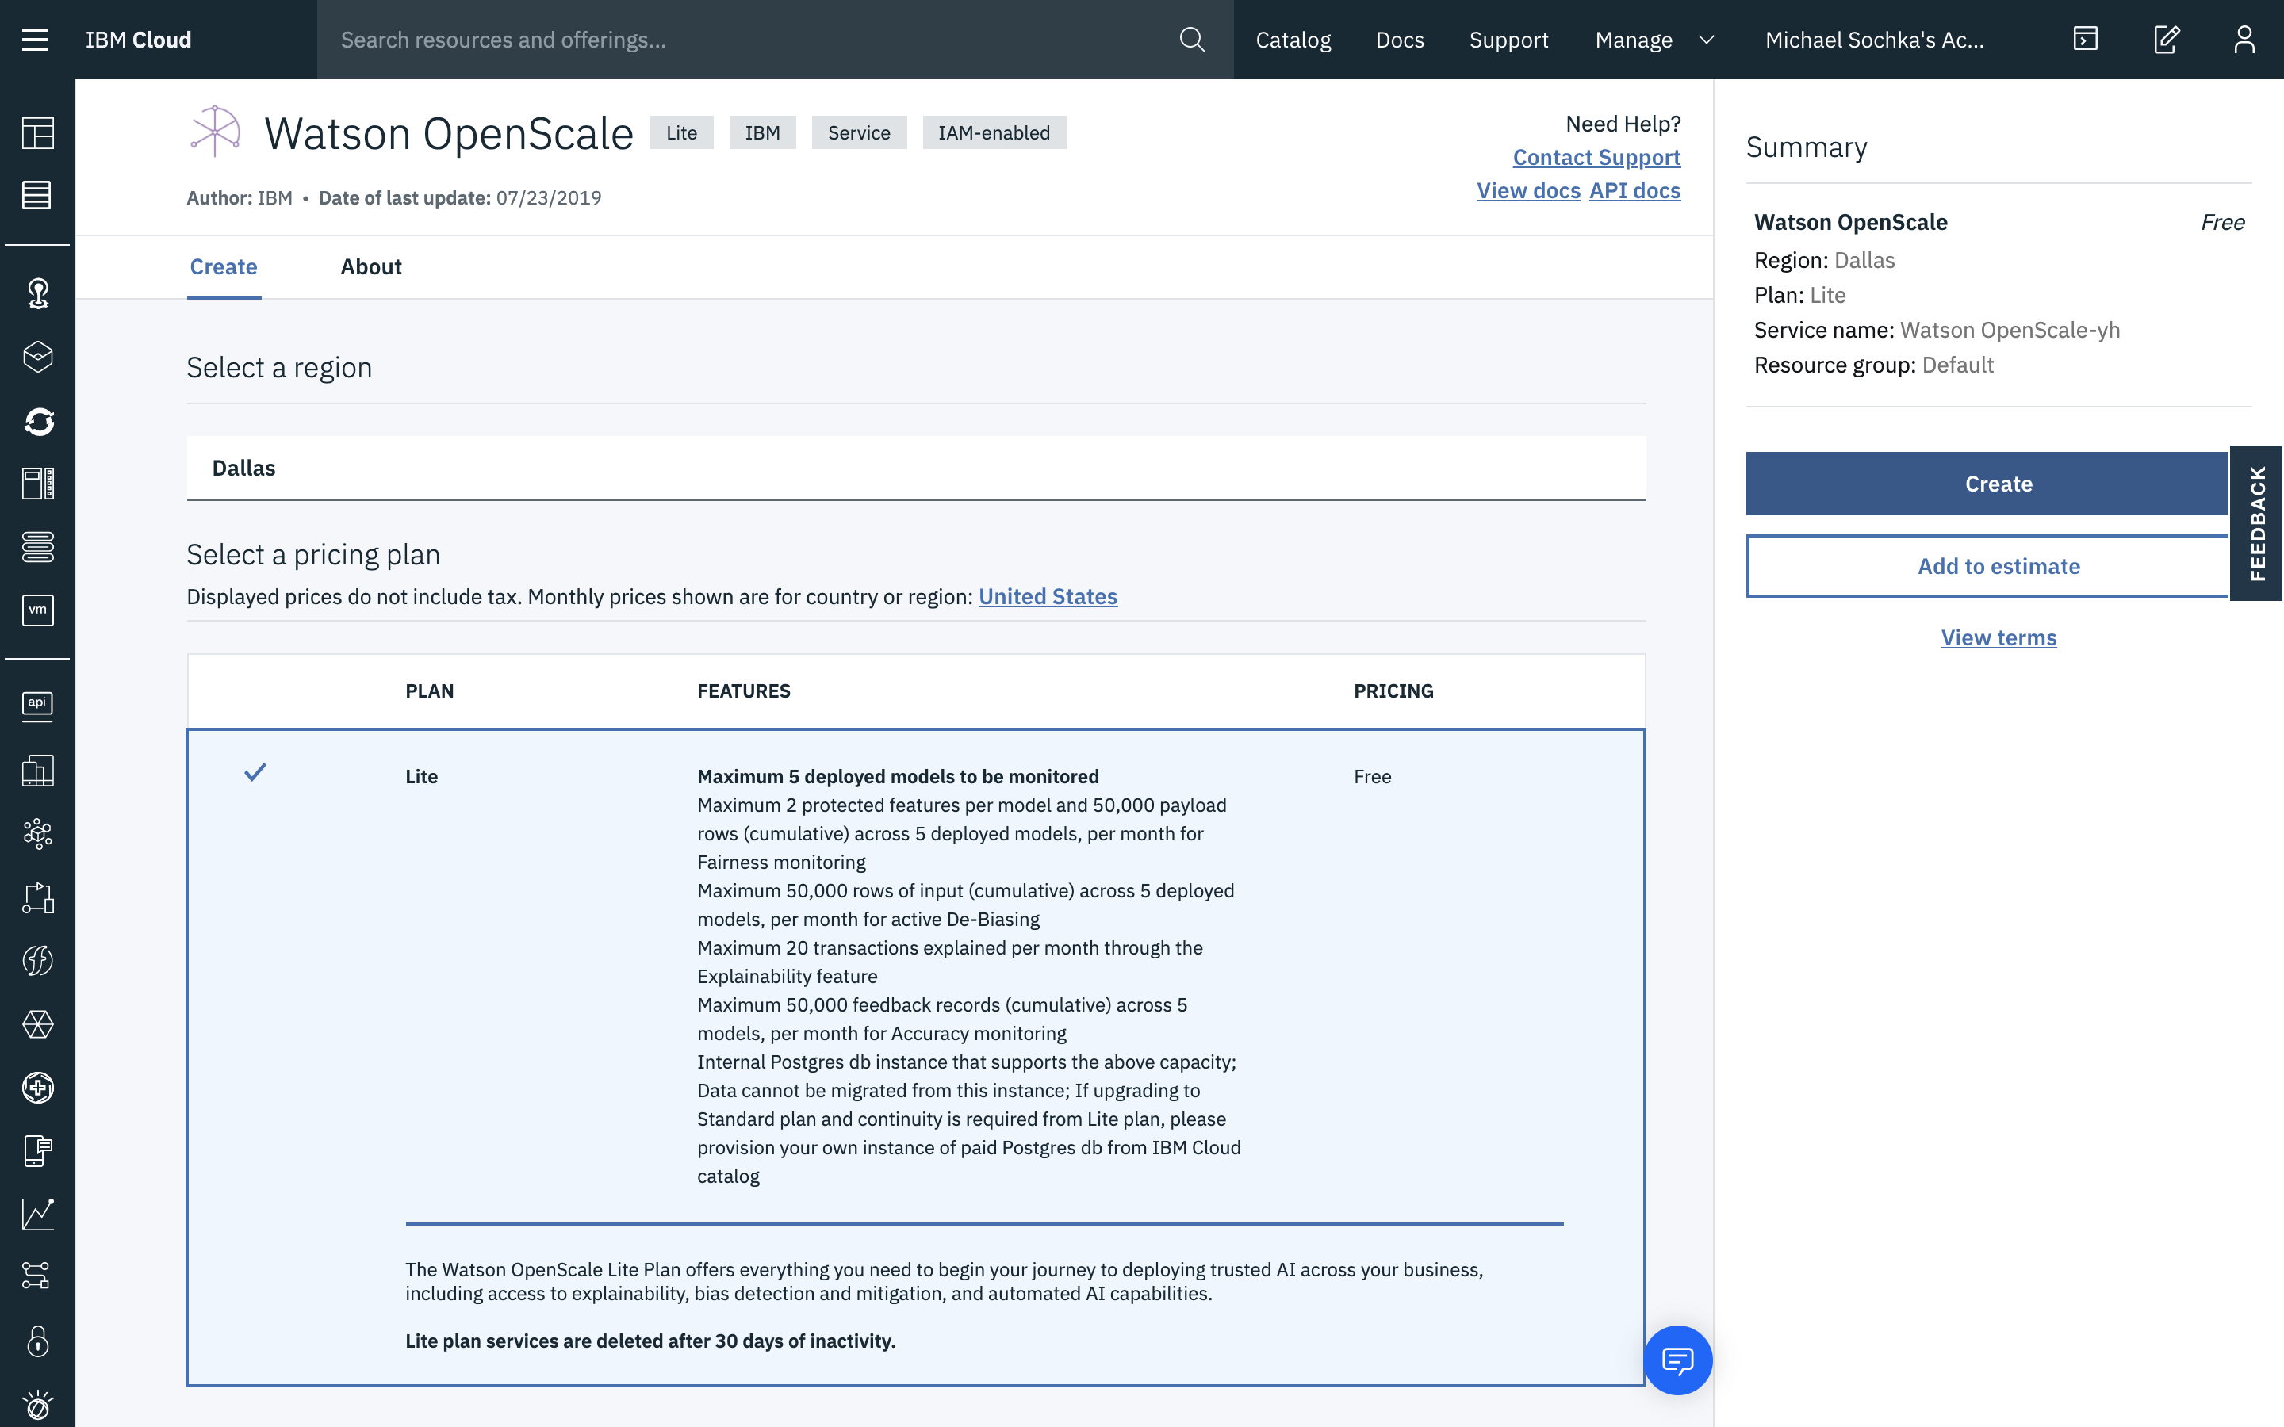

Slide 15
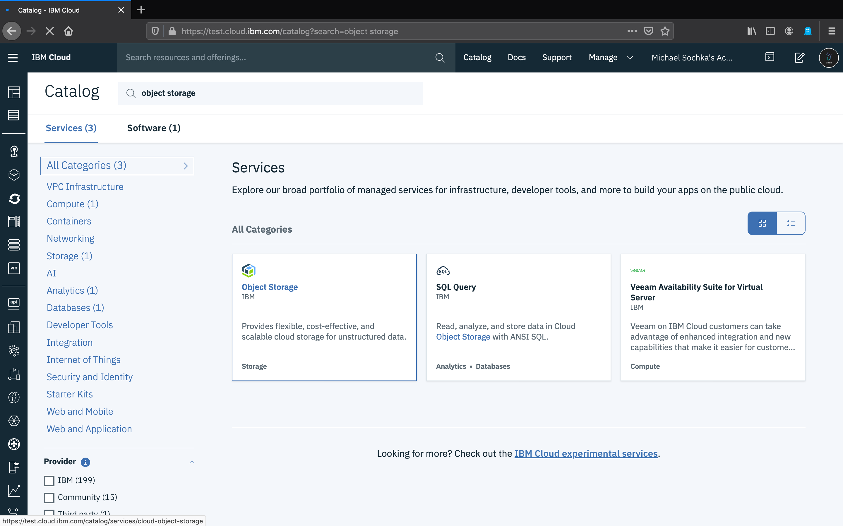

Slide 16
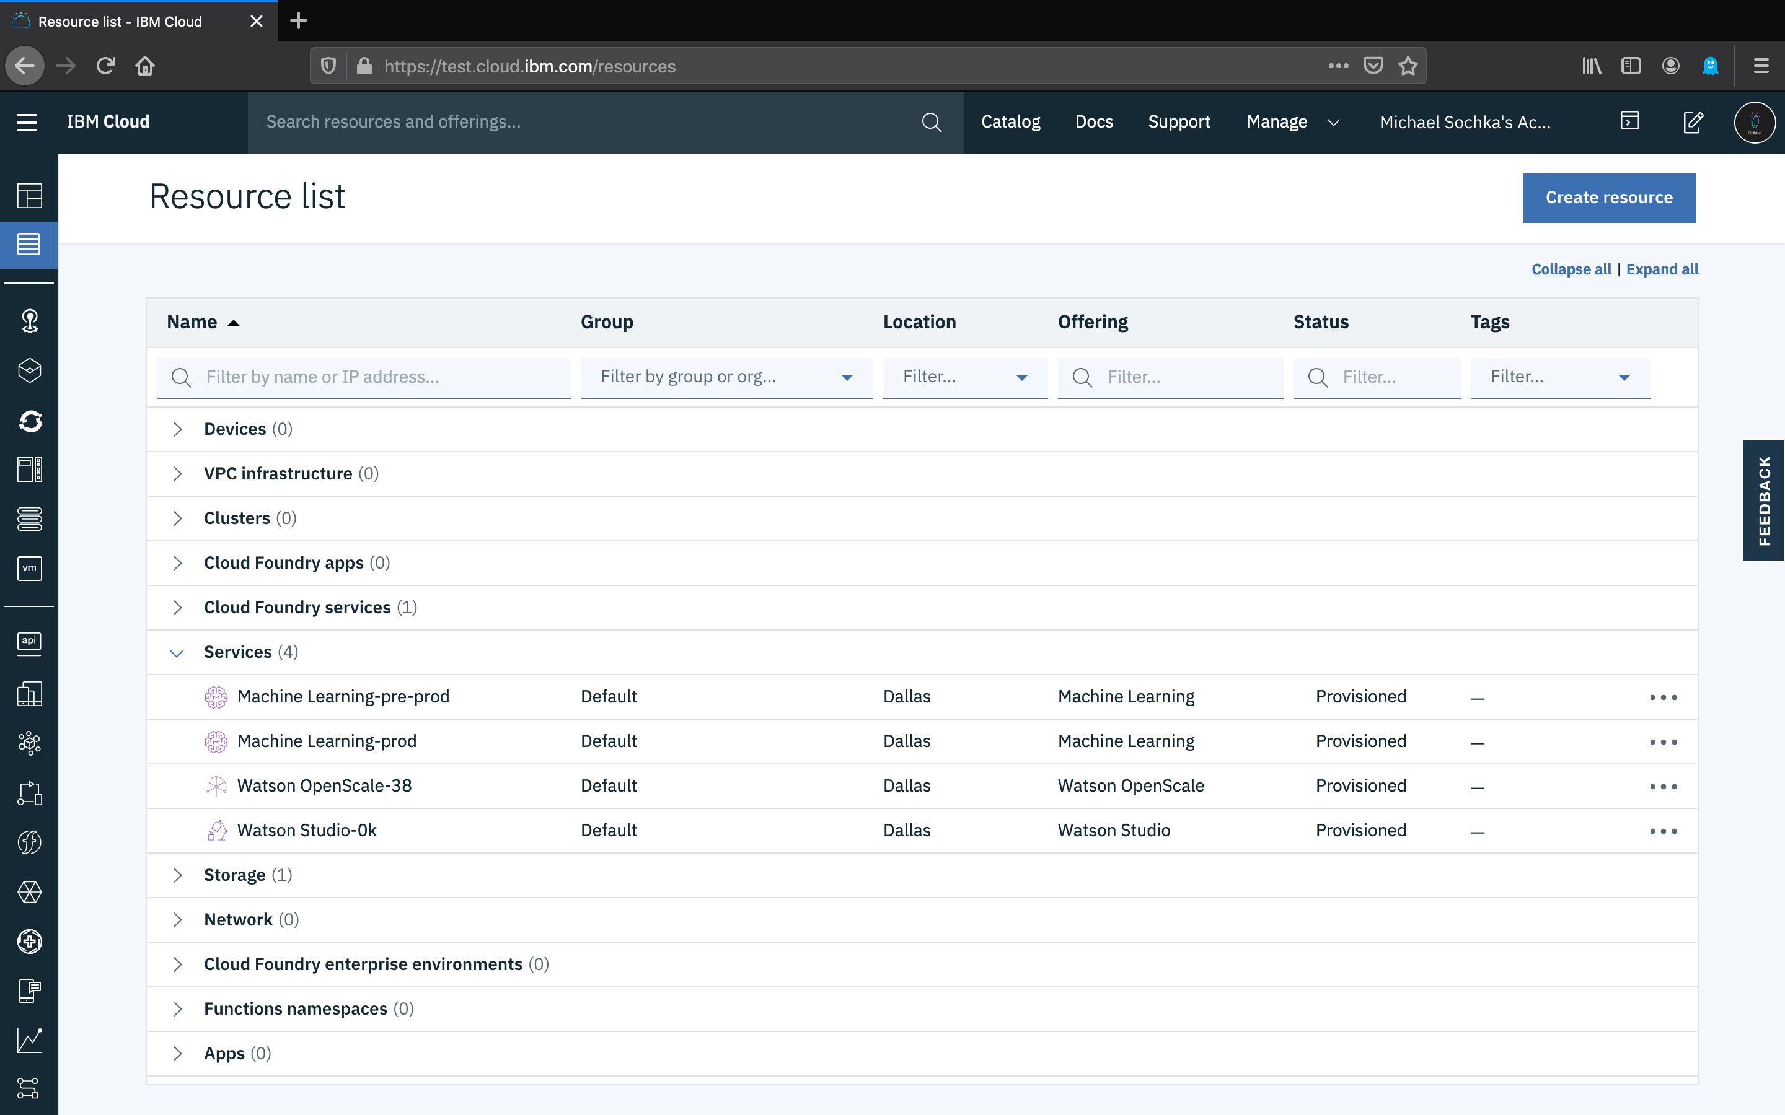

Slide 17
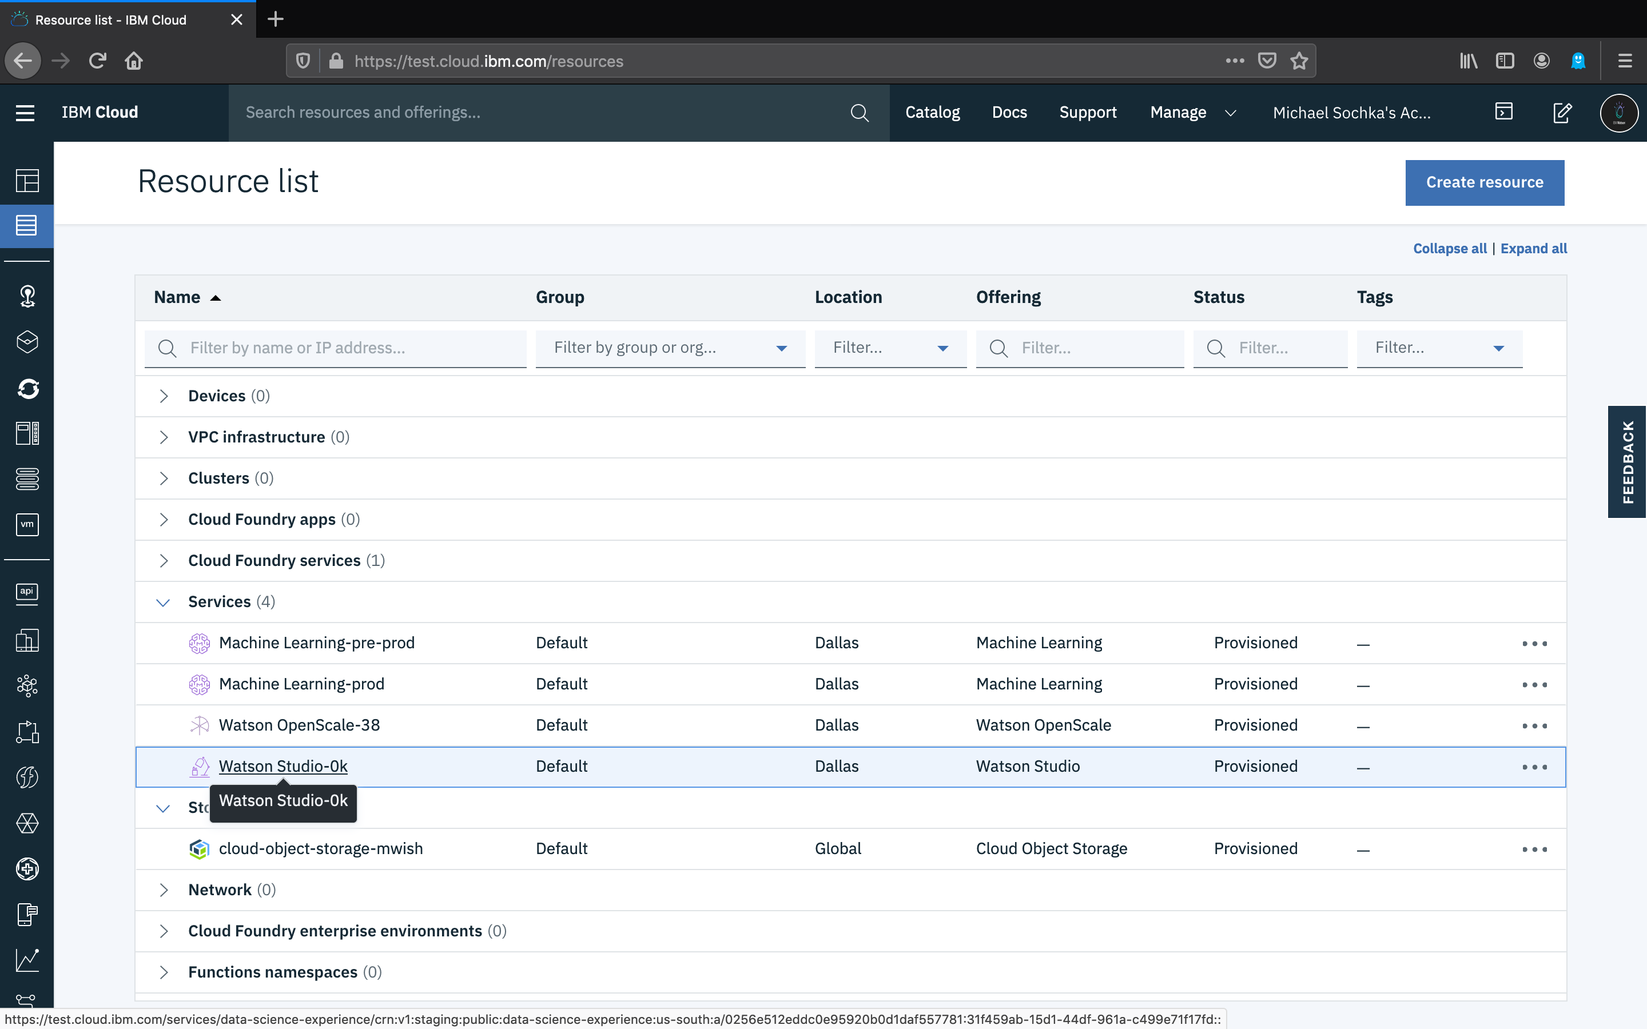

Slide 18
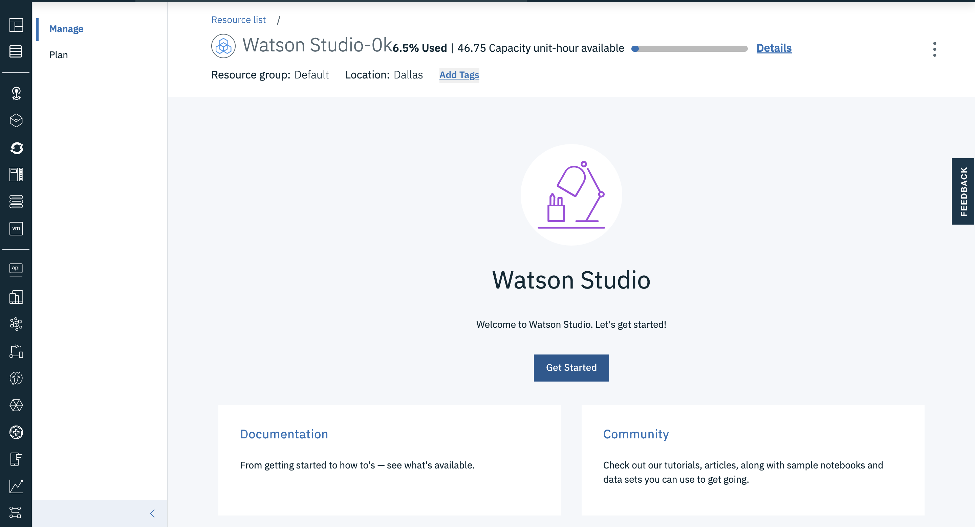

Slide 19
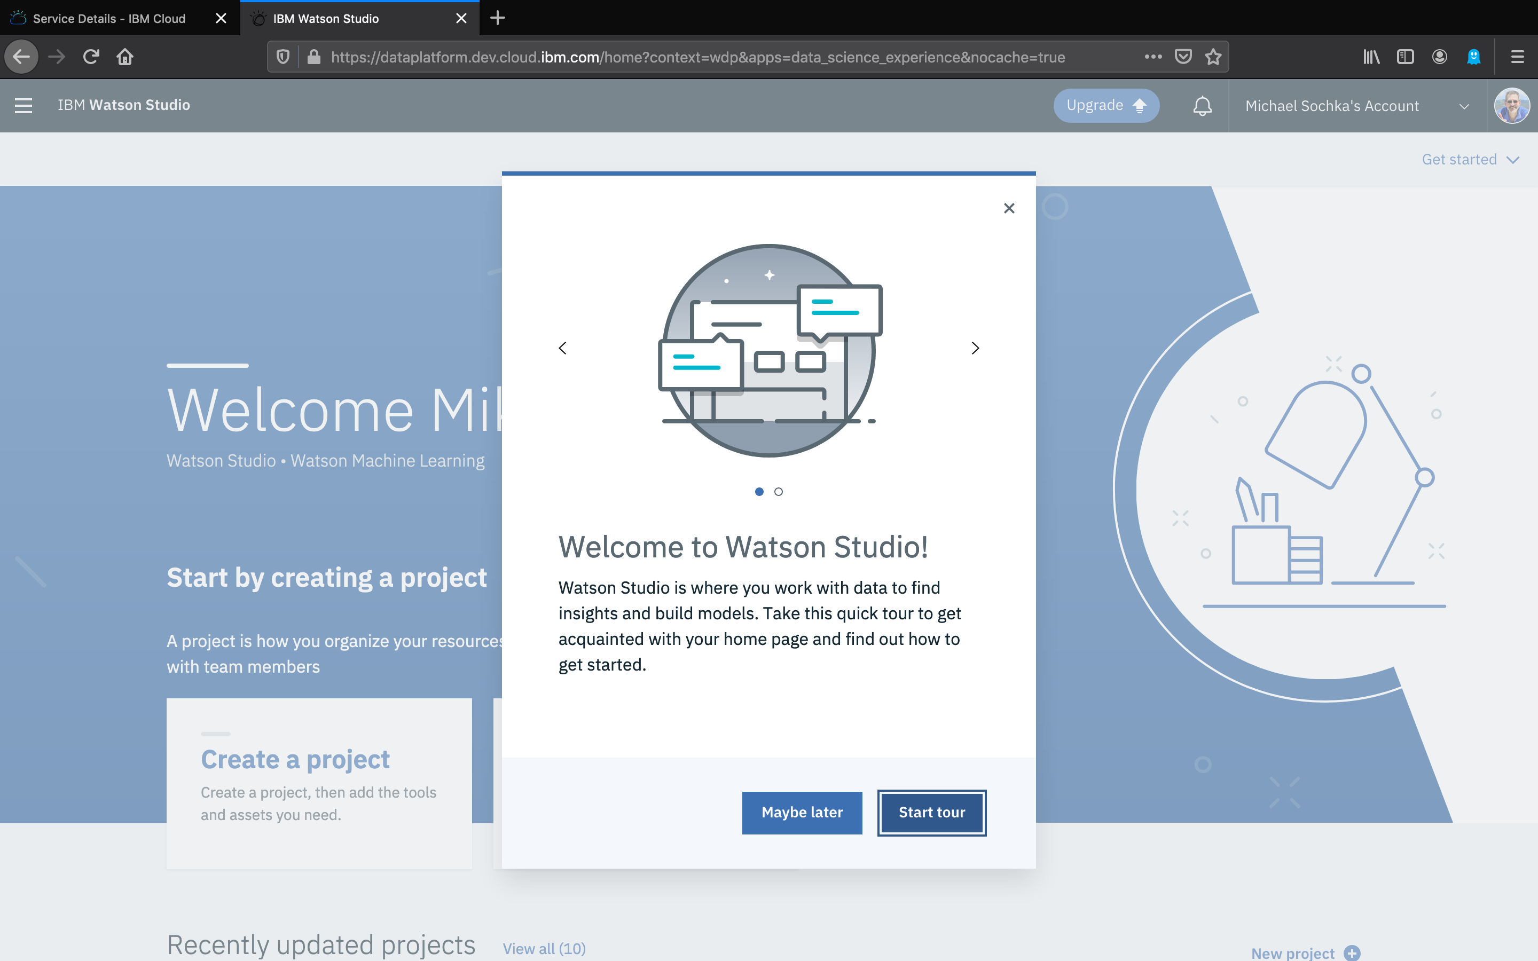

Slide 20
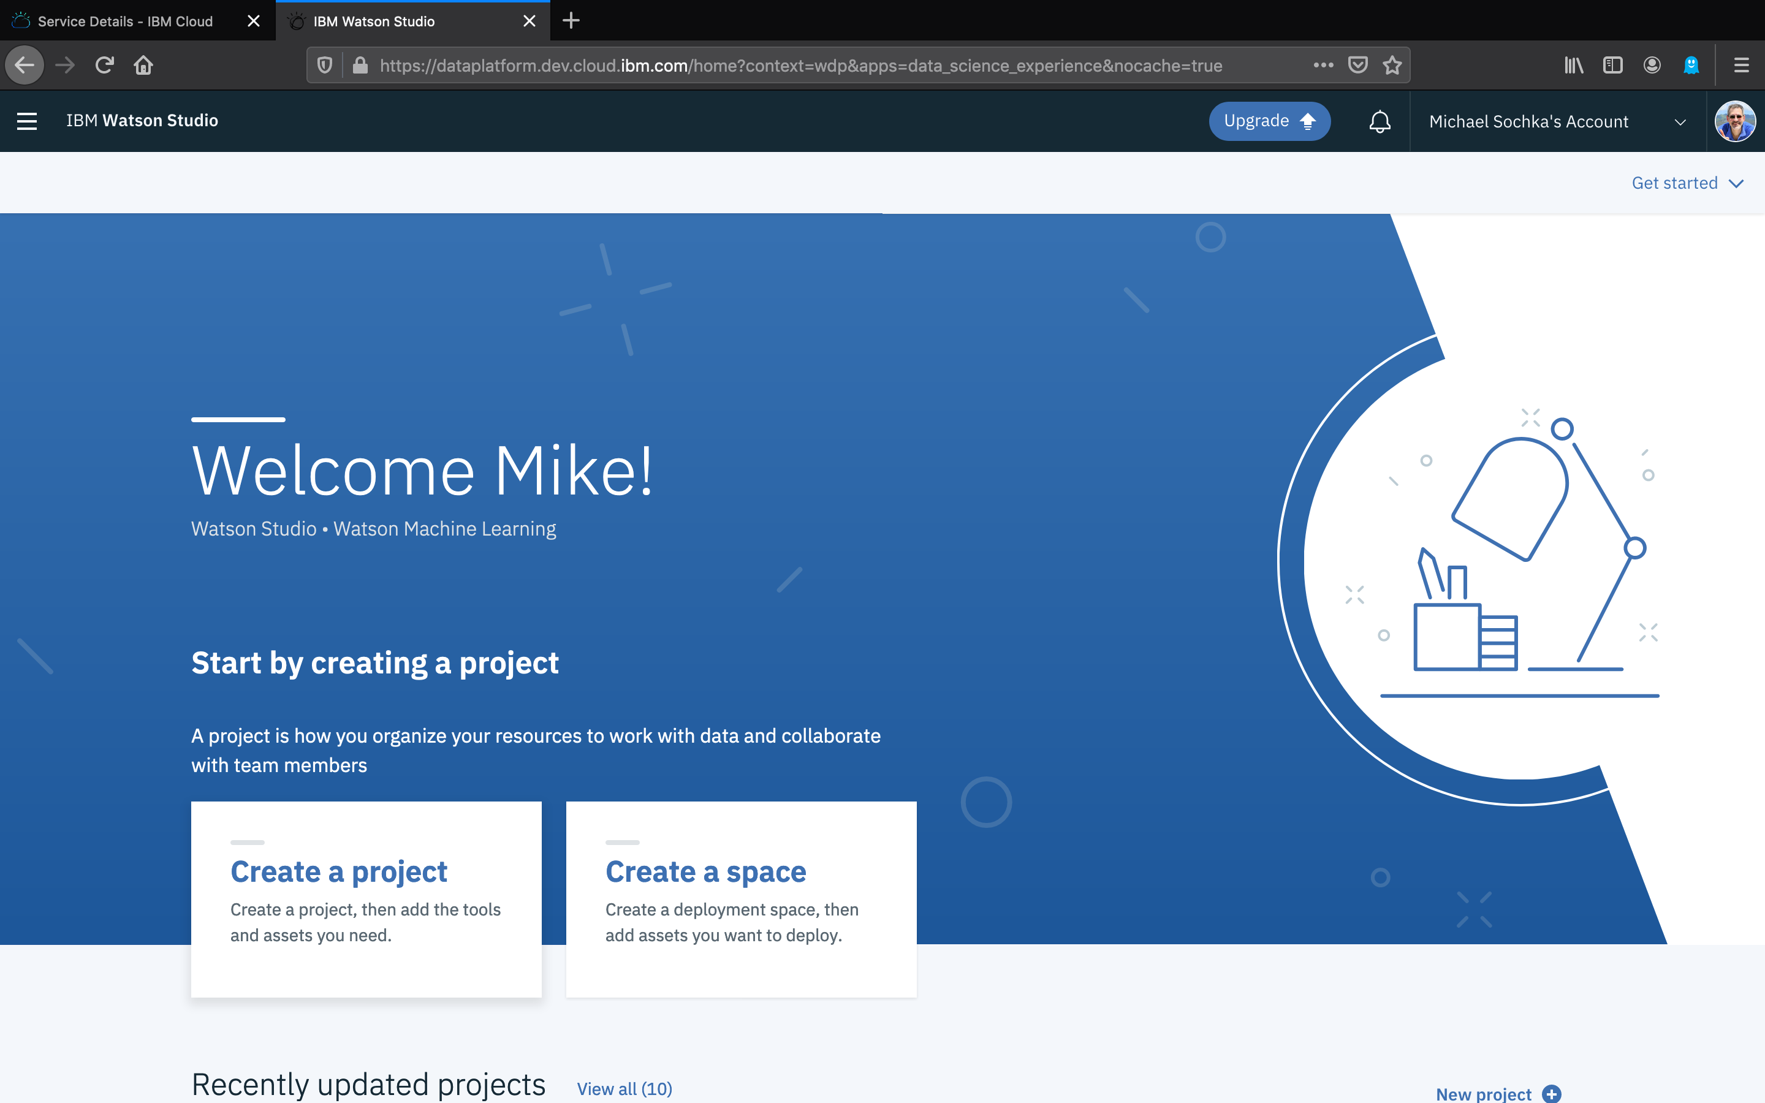

Slide 21
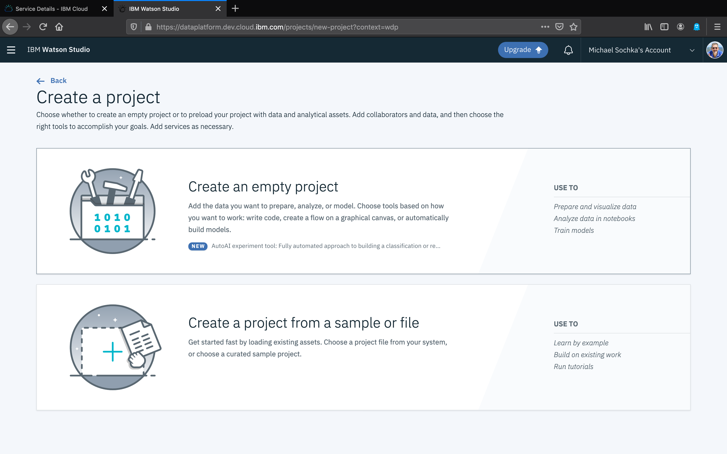

Slide 22
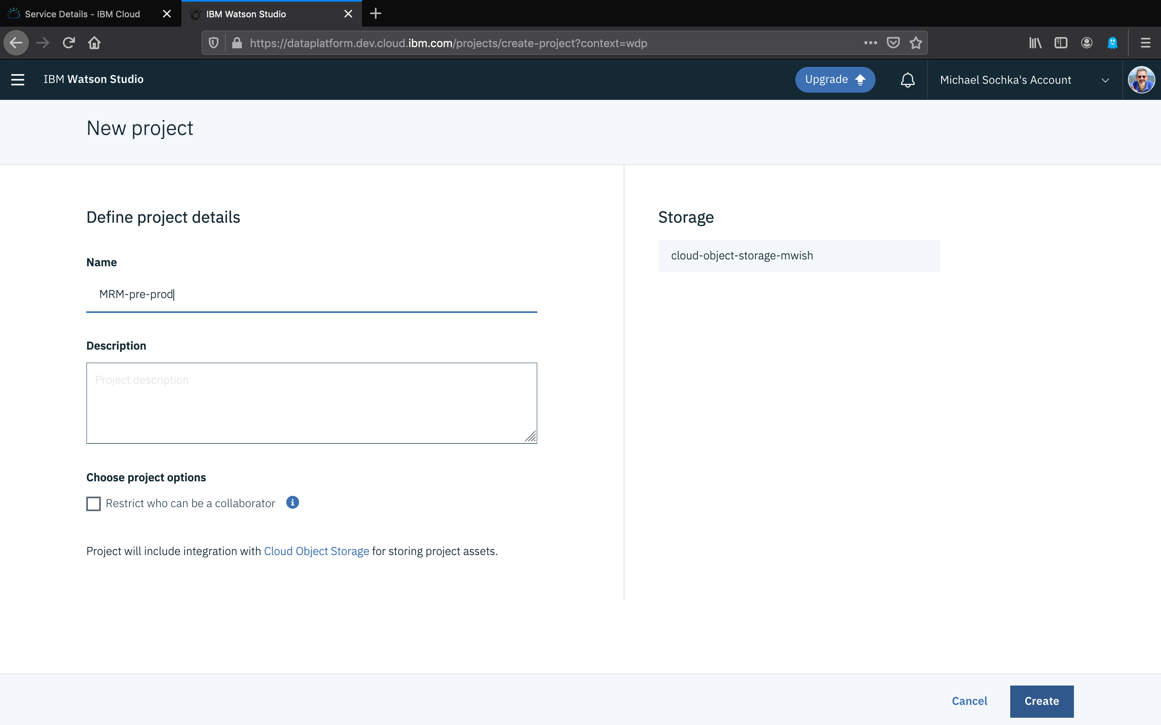

Slide 23
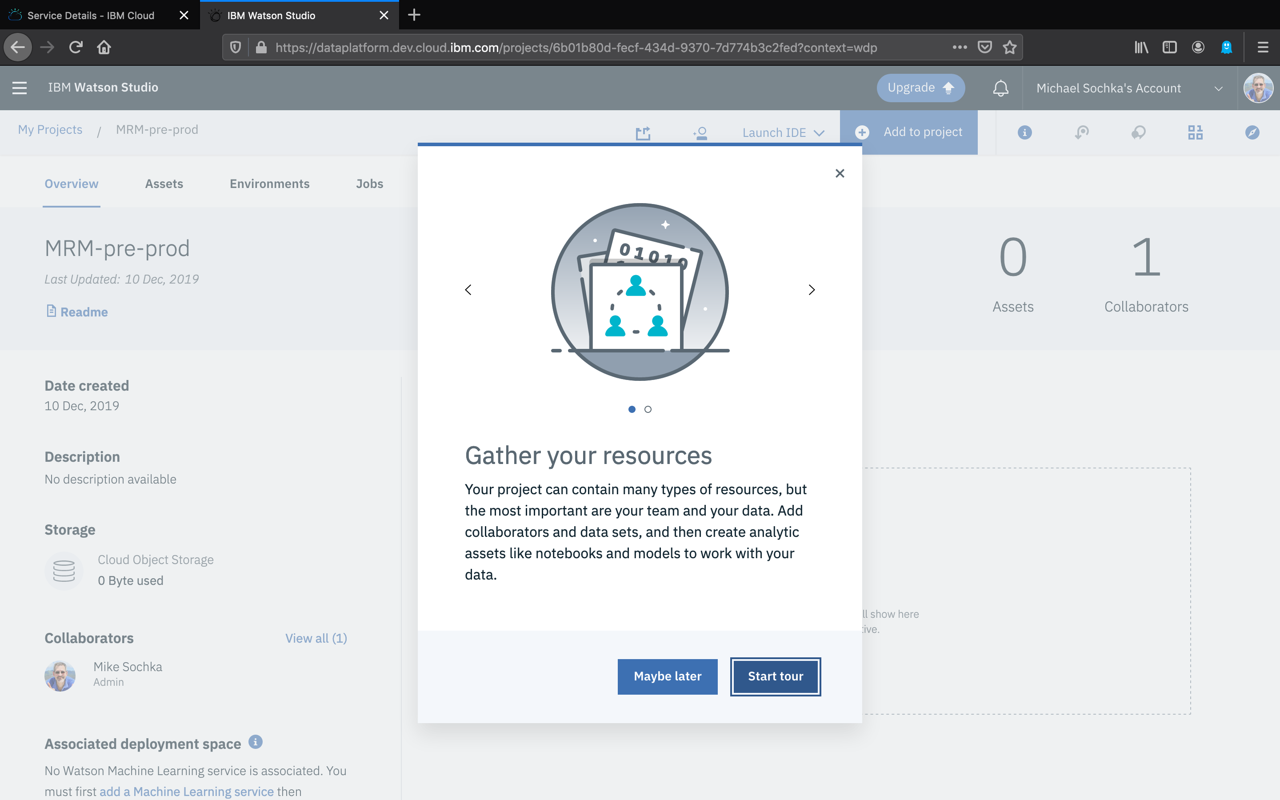

Slide 24
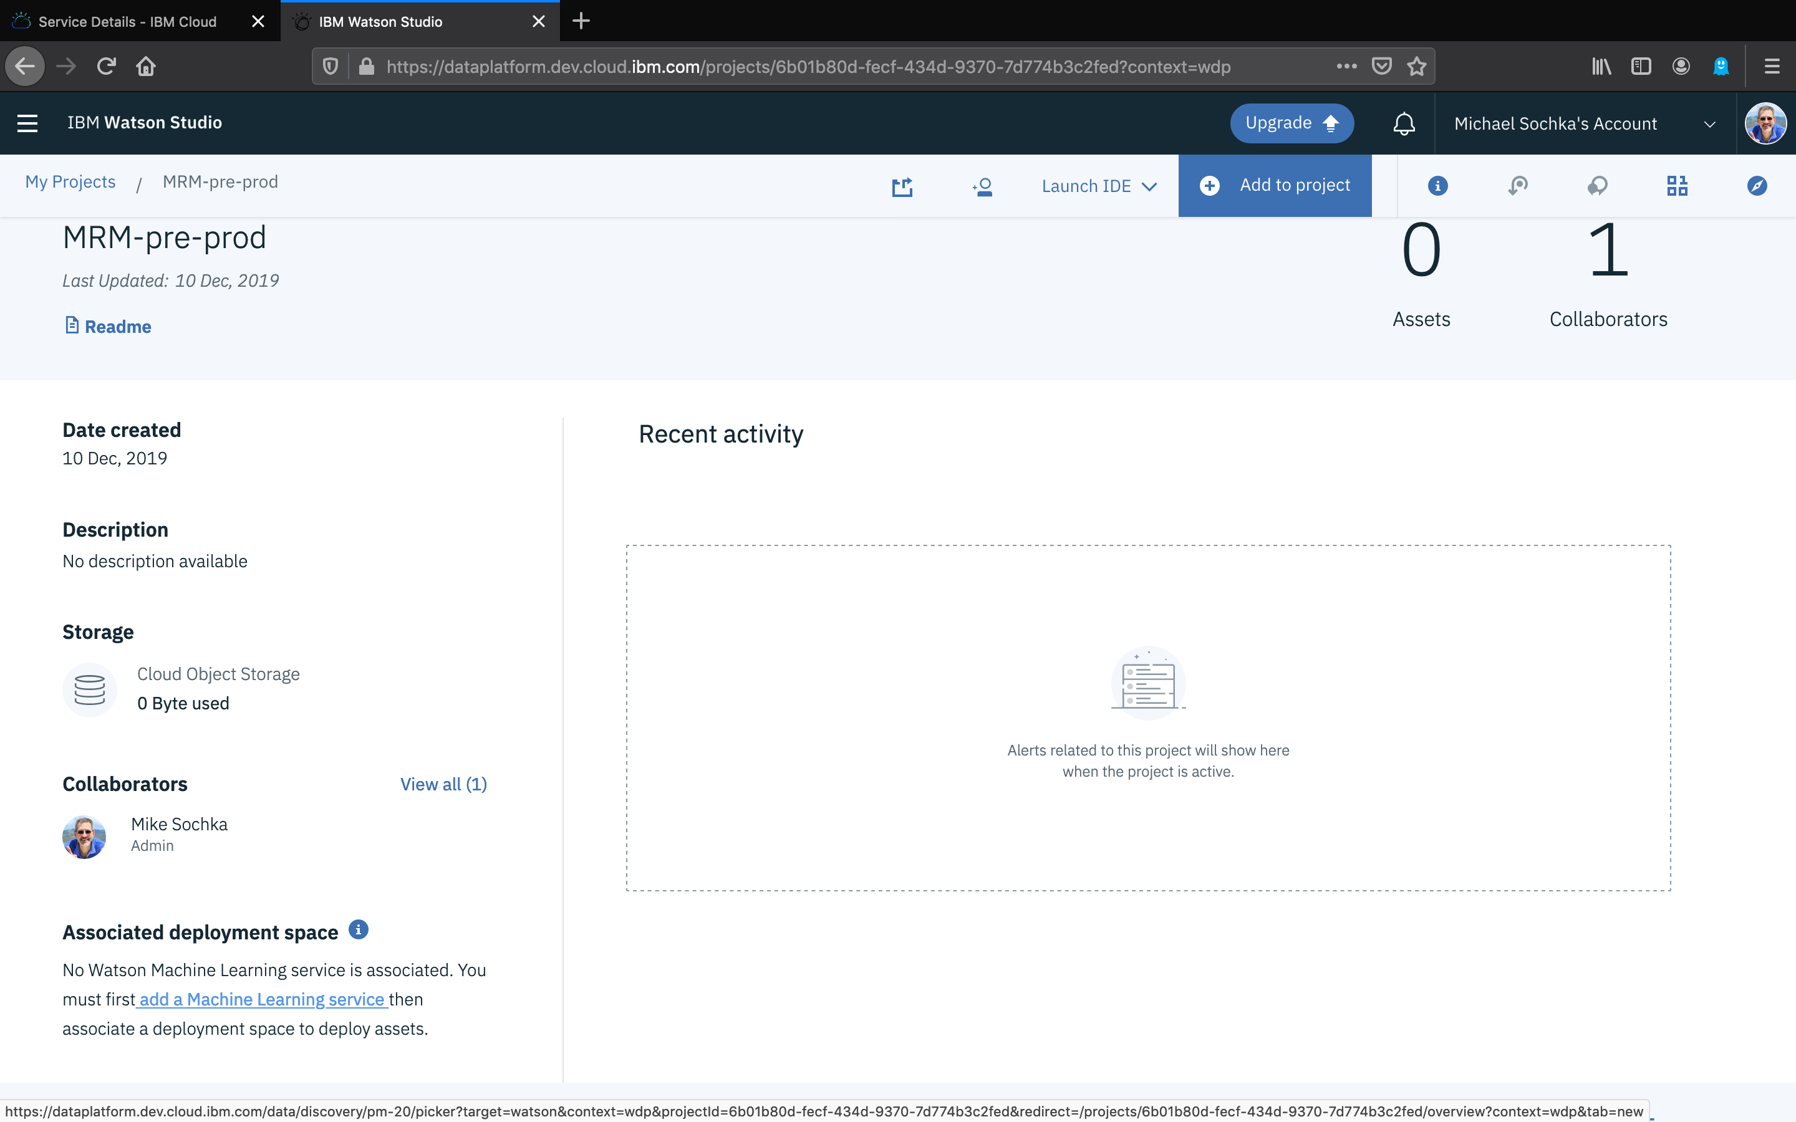

Slide 25
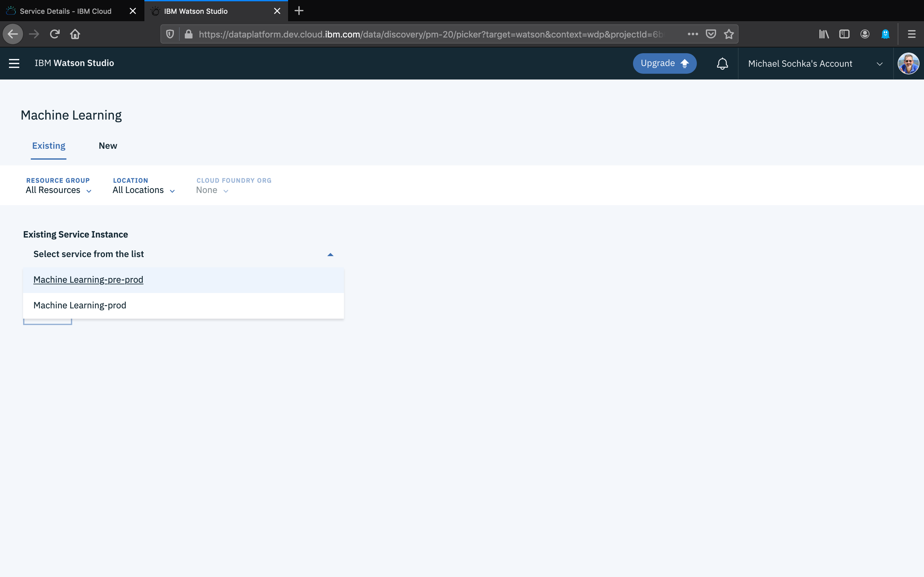

Slide 26
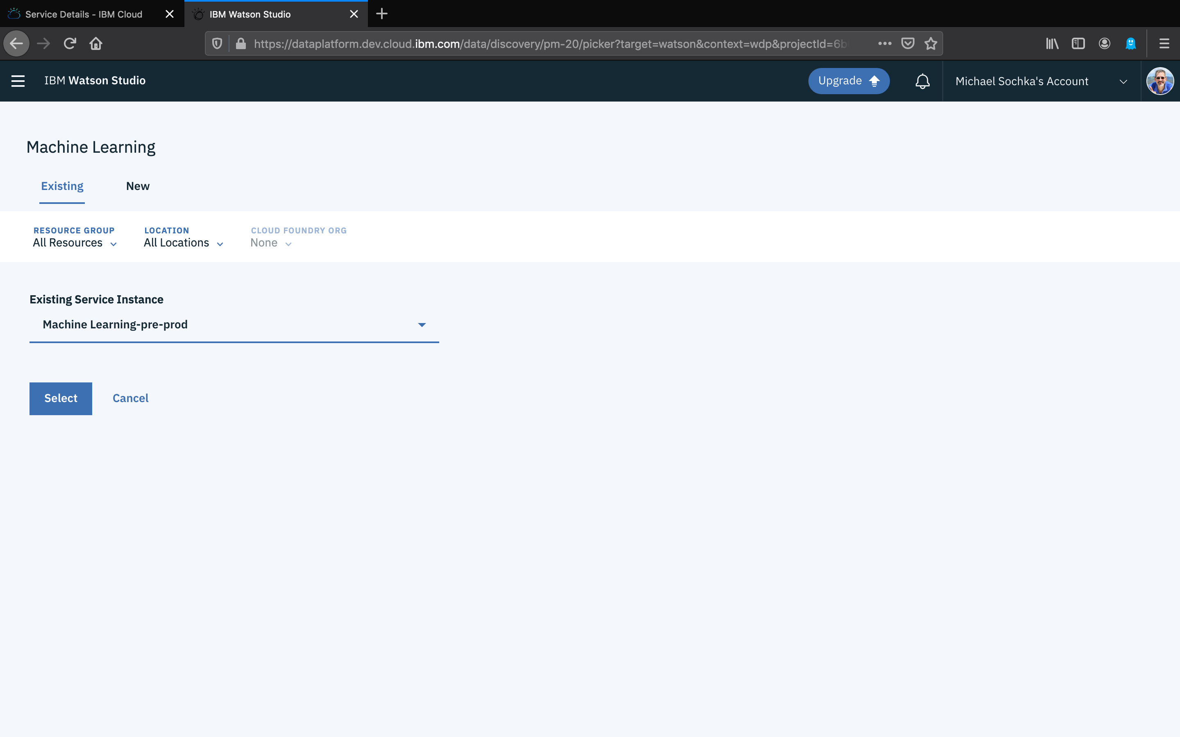

Slide 27
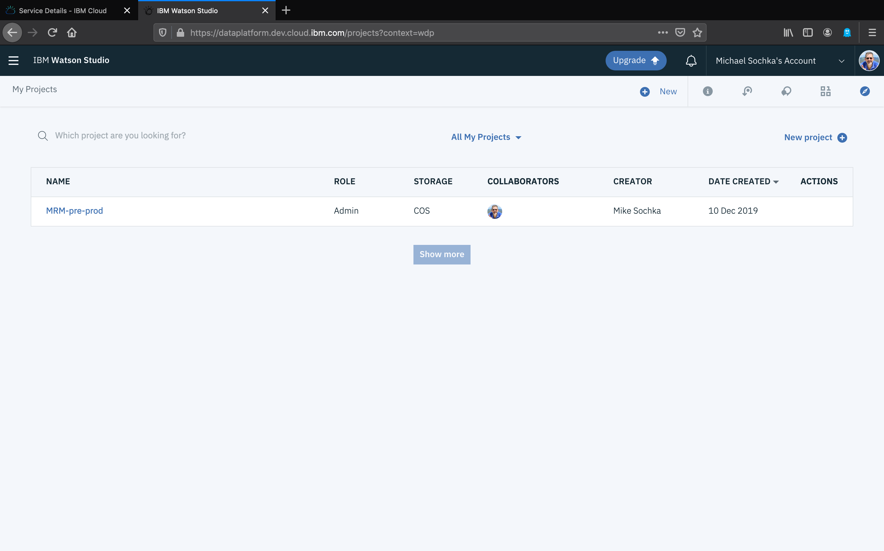

Slide 28
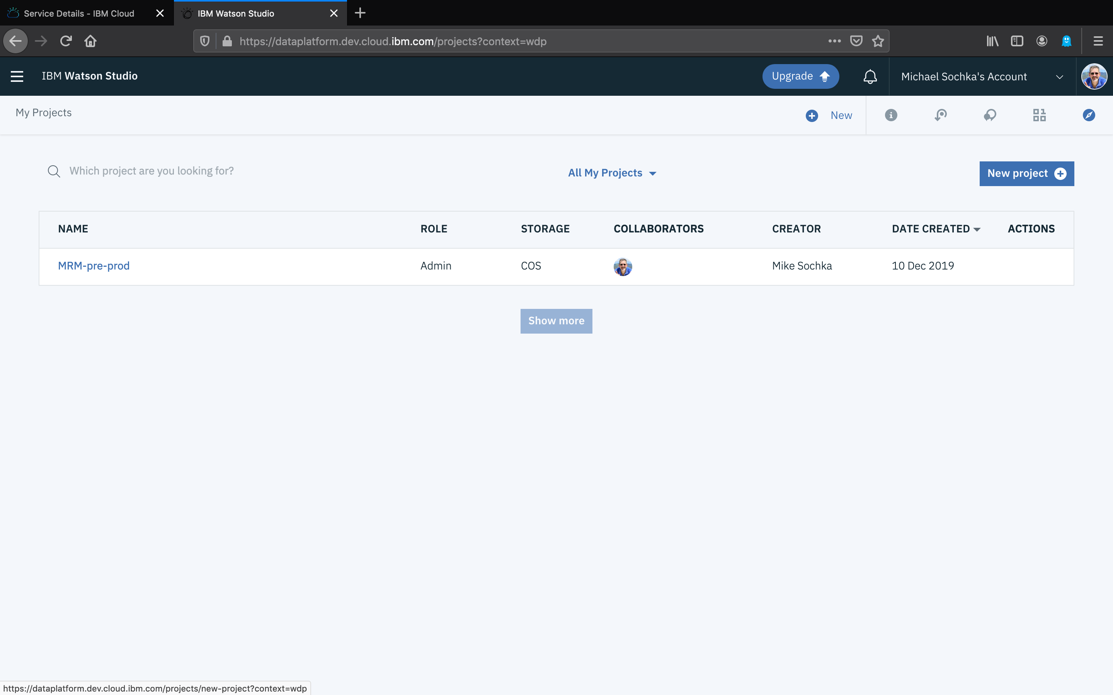

Slide 30
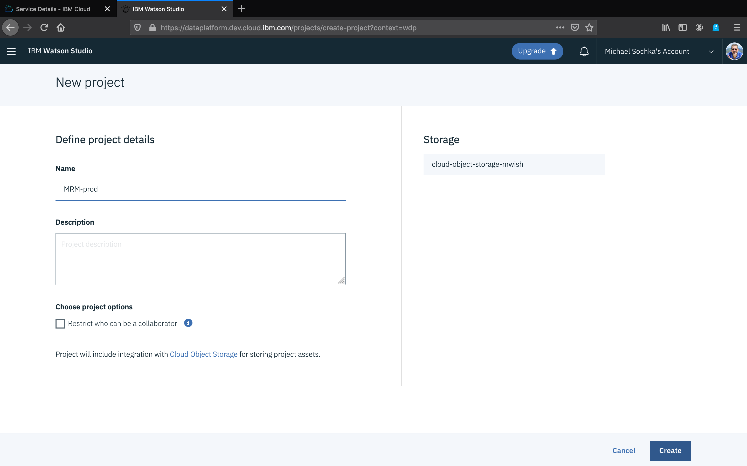

Slide 31
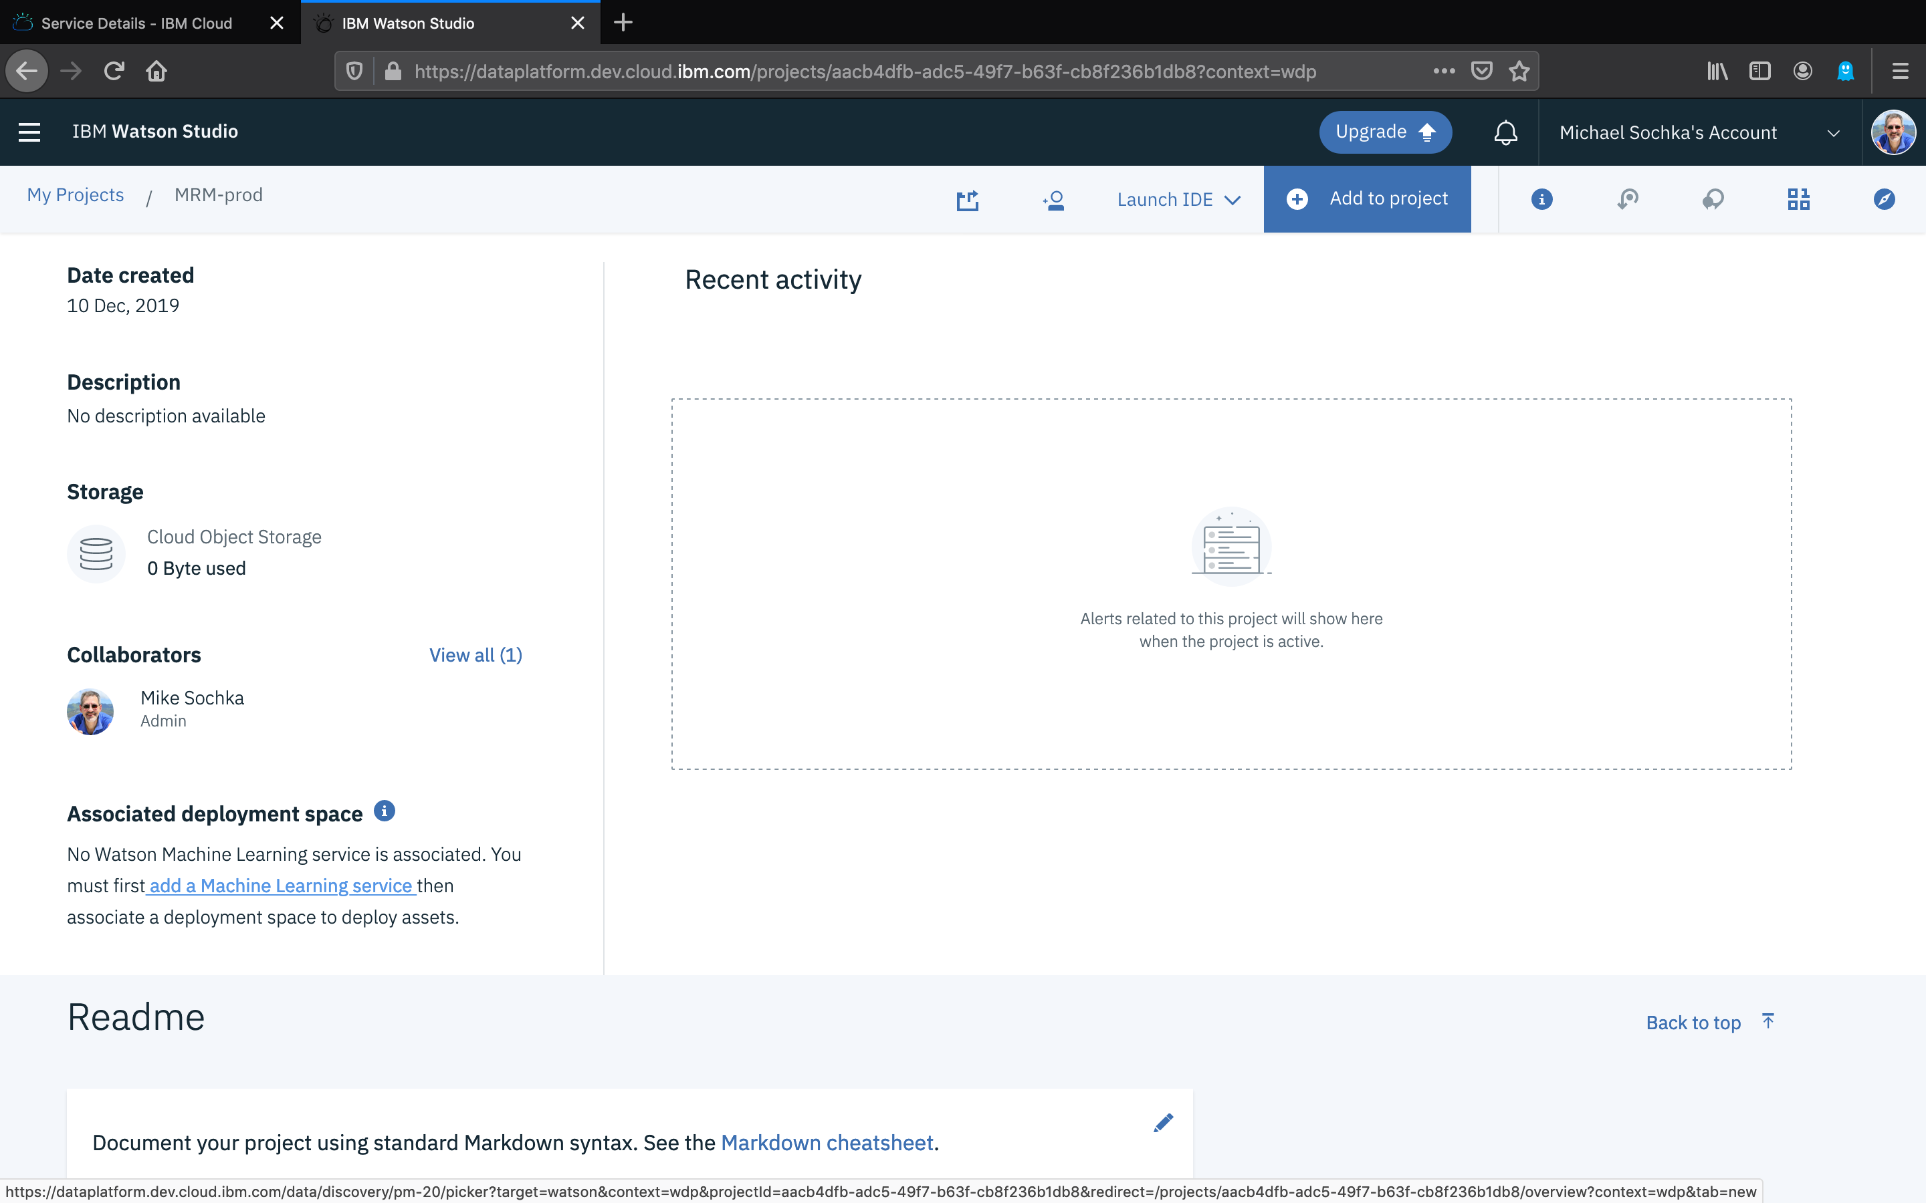

Slide 32
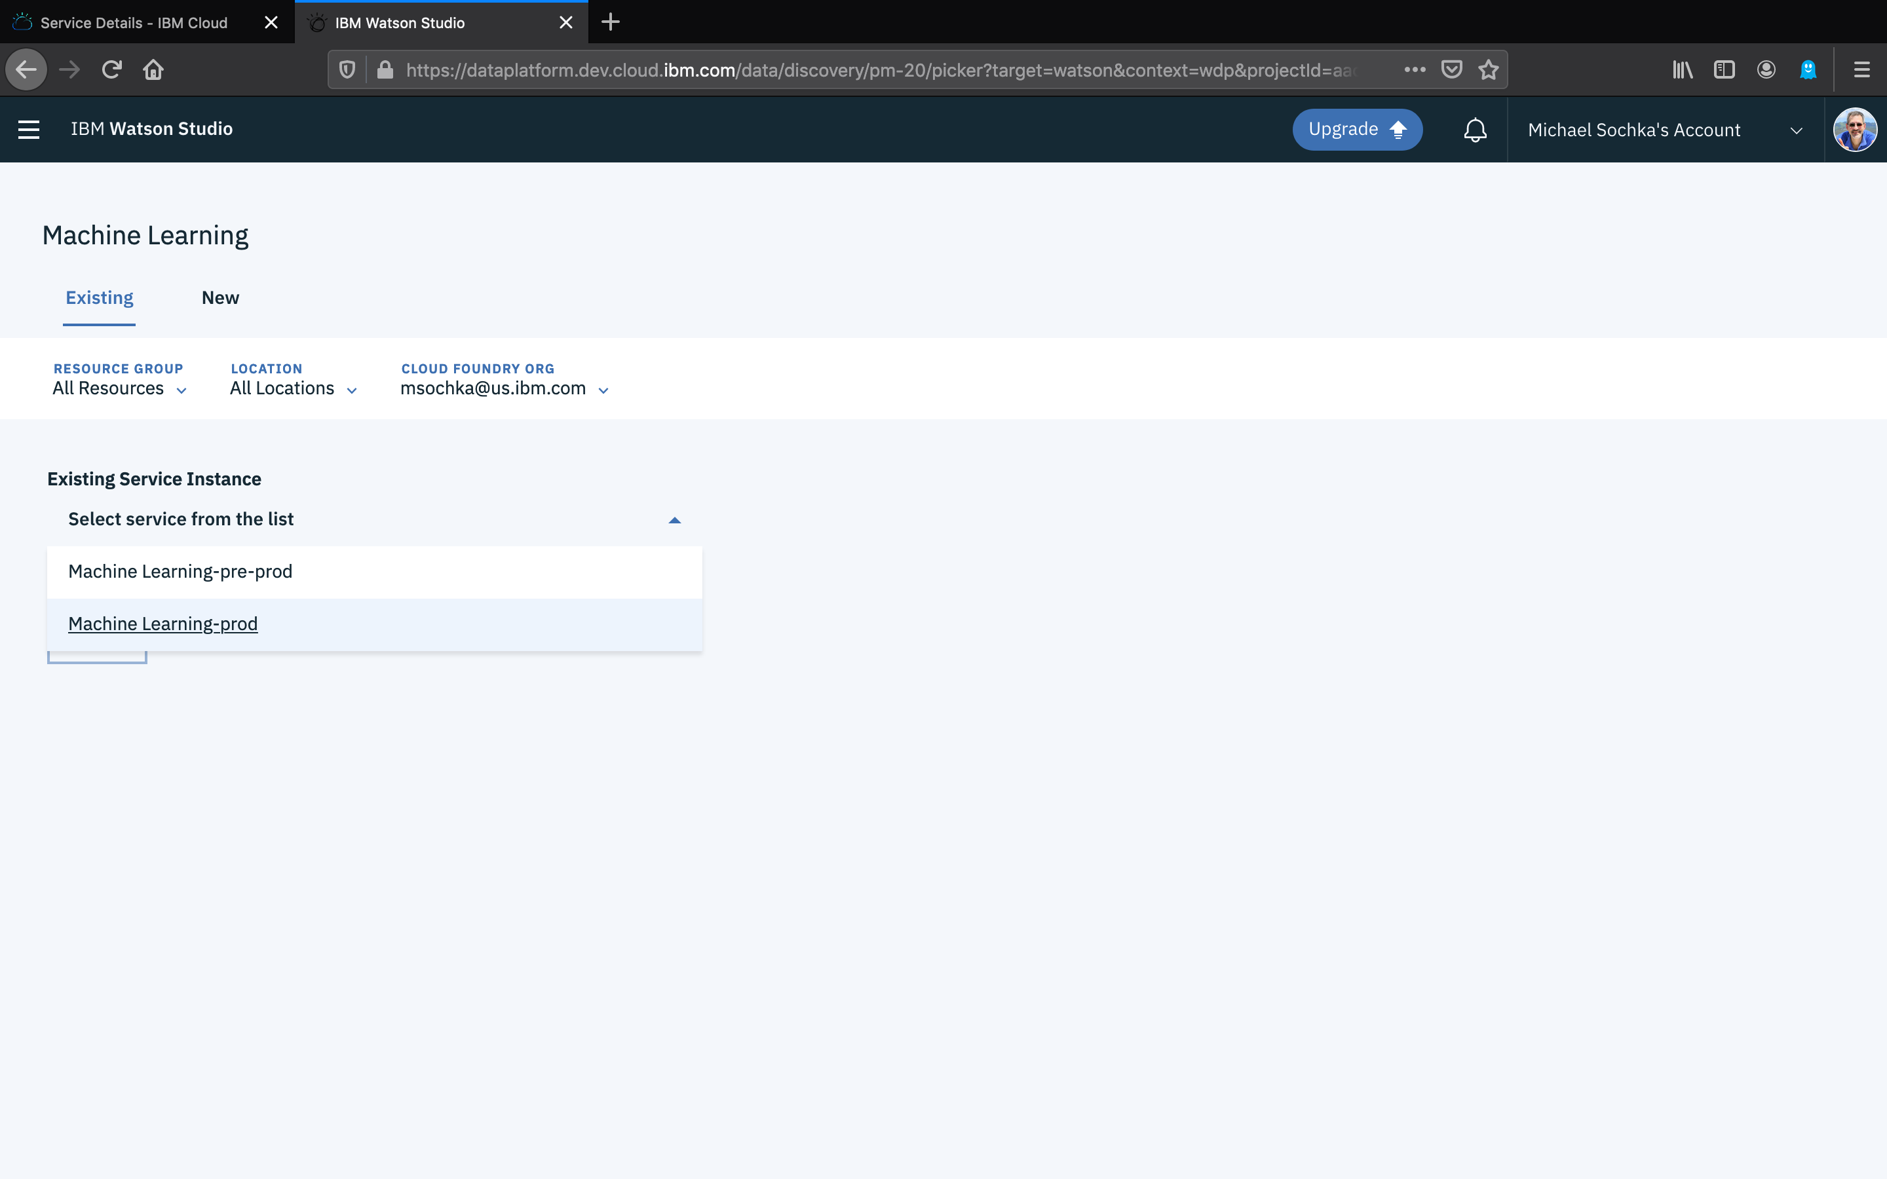

Slide 34
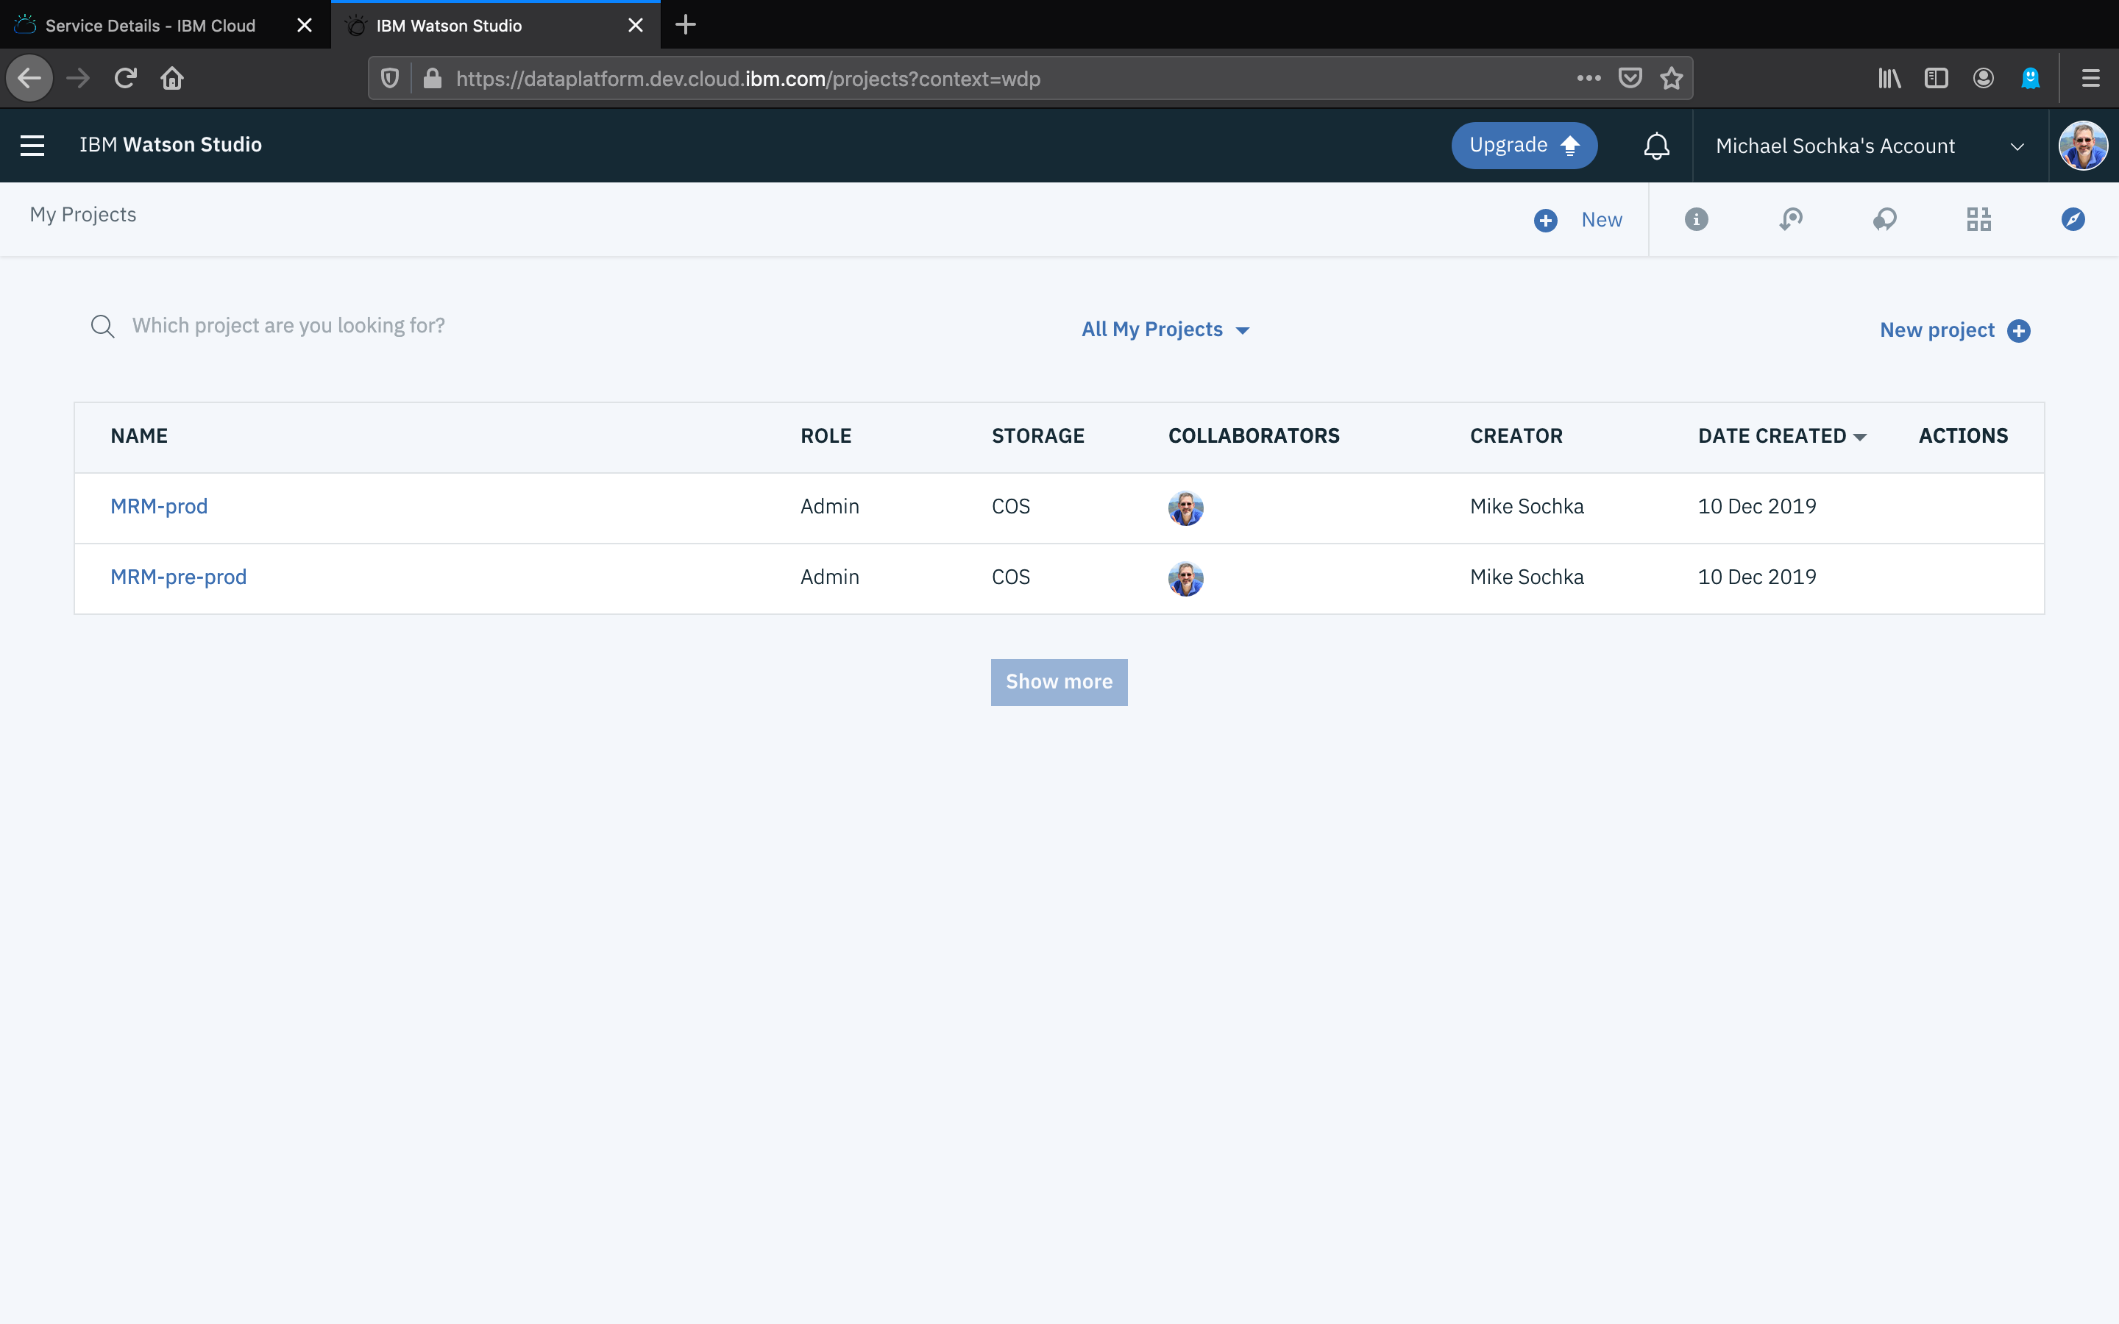

Slide 35
